Slide 1
Best Practices and Benefits of Plant Modular Design and Construction September 16, 2020

Slide 2
Contents:
Introduction
Types of Modules
Truck-able
Barge Size Modules
Domestic and Global Module Shops
Best Decisions for off site assembly
Design Criteria
Best Practices for Assembly
Standard Assembly Cycle
Benefits of Modularization
At shop
At site
Construction Industry Institute Report

Slide 3
Introduction
CII Definition of Modularization
The construction industry institute defines modularization as the “large-scale transfer of stick-build construction from the jobsite to one or more local or distant fabrication shops/yards in order to exploit one or more strategic advantages”.
Notes:
Drivers for Modularization-
Downstream Construction, maintenance and engineering conference roundtable- 2017
1.Attrition is reducing experienced and skilled work force- In the last ten years, 16-24 year old new entrants are down 32%- by 2030- 60%
In the last ten years, boomers leaving the workforce have increased by 63%- 83% by 2030.
2. Off site assembly reduces crafts and services at a G/R or B/F site, risk factors, schedule assurance
3. Mega projects (LNG,Ethylene) are most affected- Can have up to 7,000 craft and support at site.

Slide 4
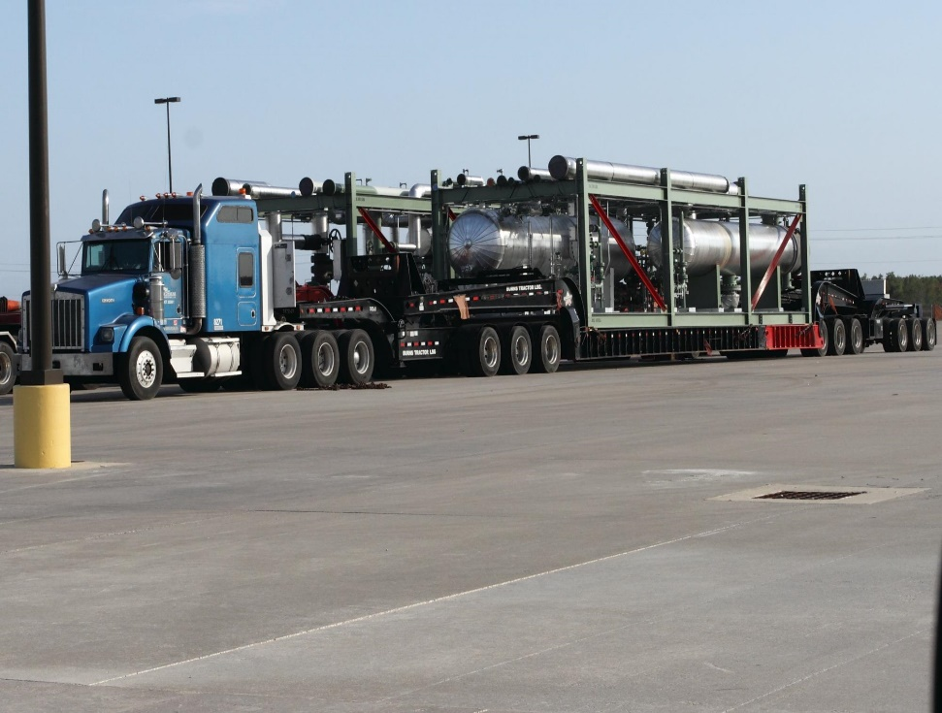
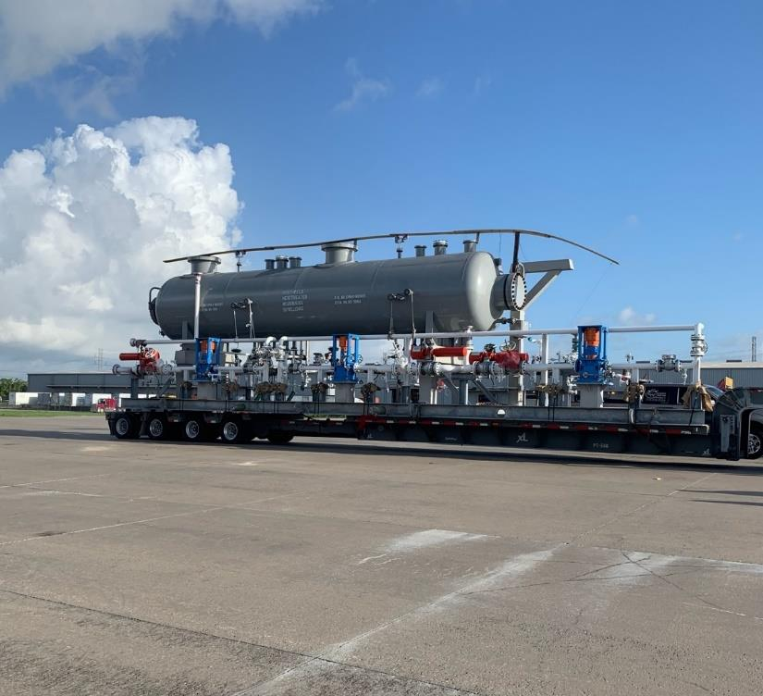
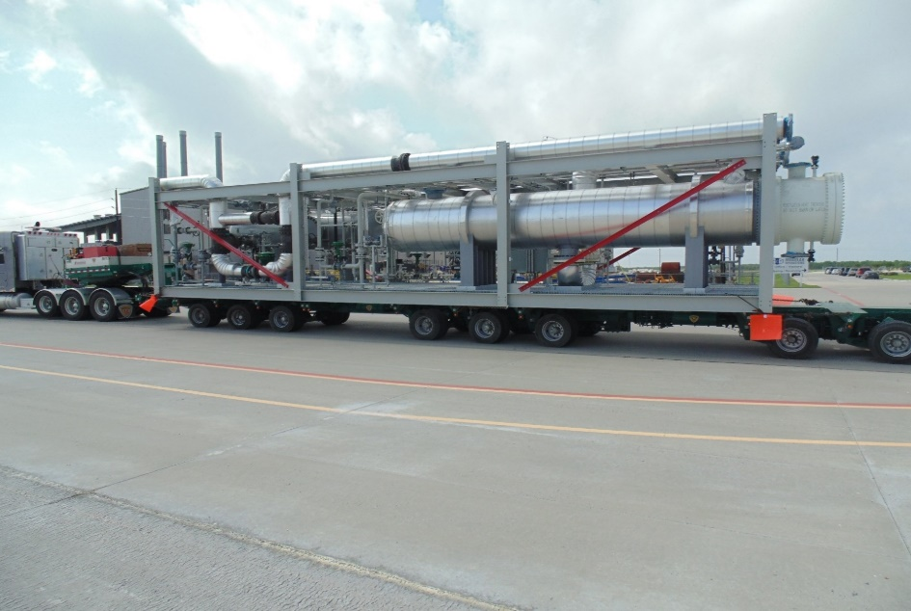
Truck-able Process Modules

Slide 5
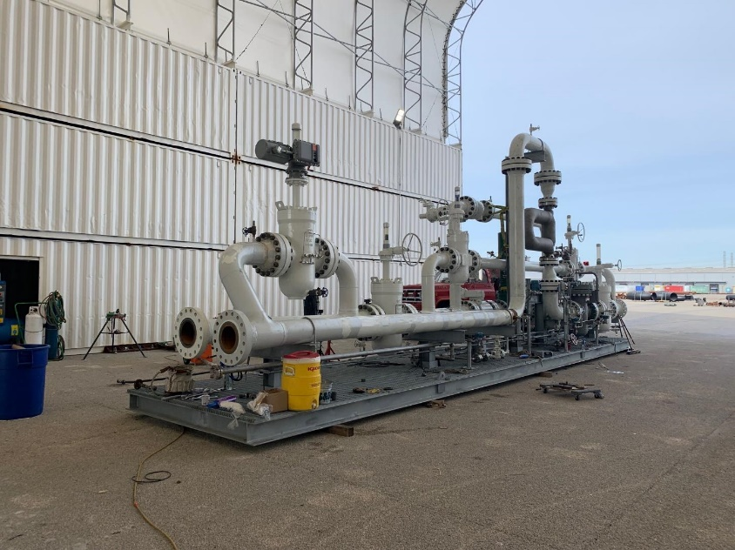
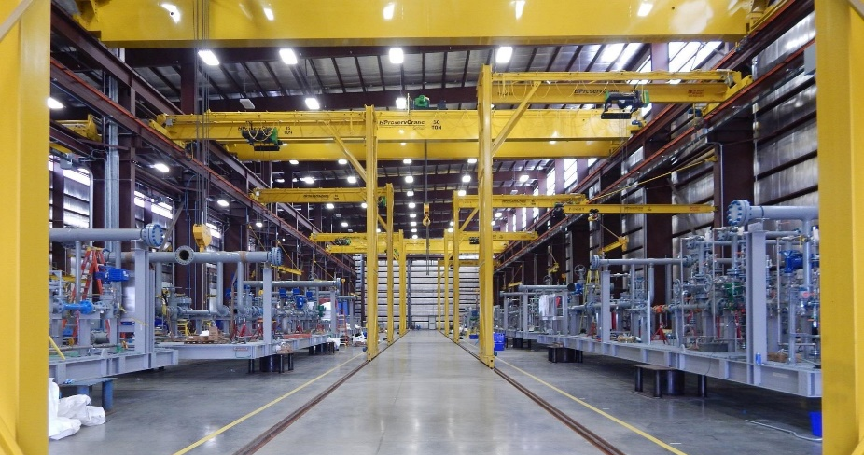
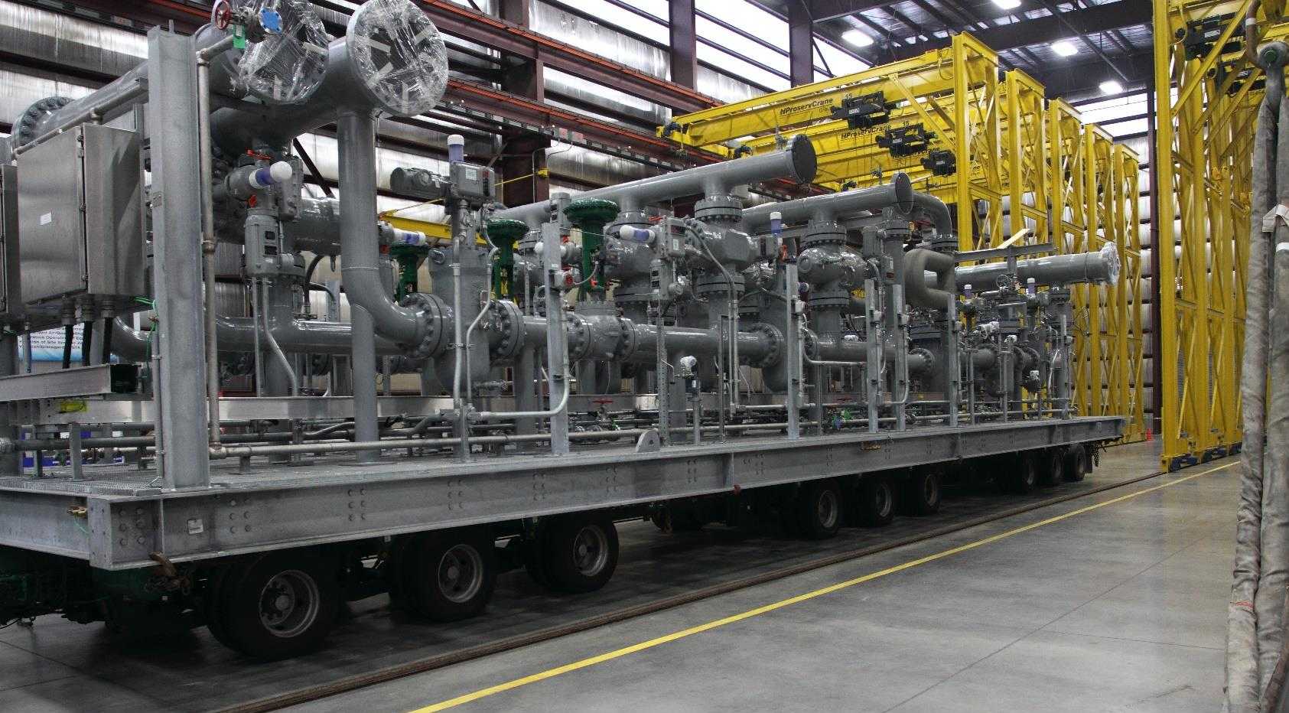
Truck-able Metering Skids
Notes:
Easily assembled in module shops and transported to greenfield sites. Repeatable construction reduces overhead costs, improves productivity, and reduces cost per assembly.

Slide 6
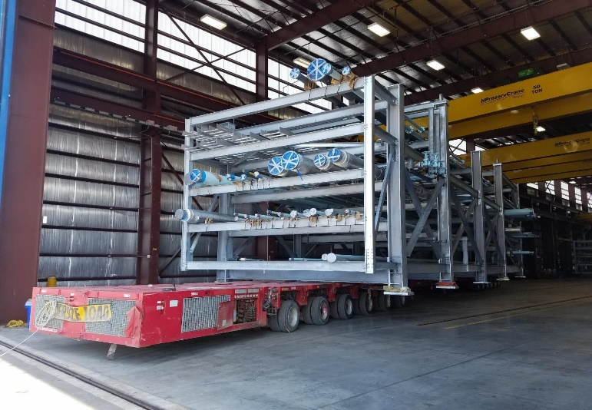
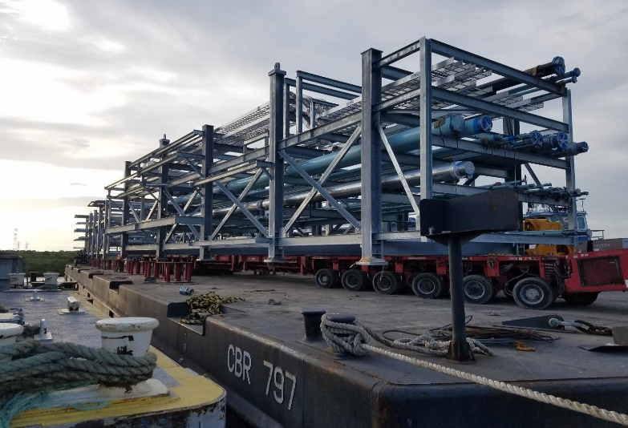
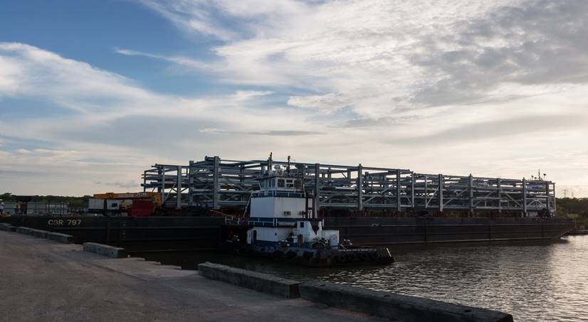
Barge Size Pipe Rack Modules
Notes:
Domestic and International engineers and owners are using domestic shops for pipe rack assembly. Pricing is competitive when freight costs are considered. Change is more easily managed at domestic shops.

Slide 7
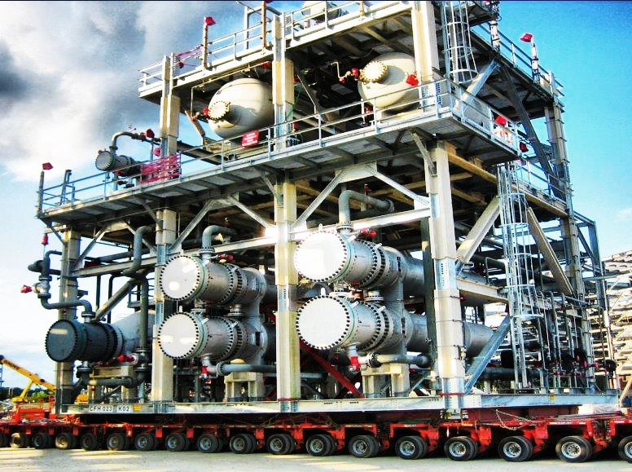
Barge Size Process Module
Notes:
Mega modules (1,500 tons and larger) are usually built overseas, labor and material costs are more competitive and overcome shipping if site is close to water access.
Production and schedule concerns due to Coved and 232 are brining some large assembly projects back to the U.S.

Slide 8
Domestic and Global Module Shops
Significant growth in the number of North American skid and module fabricators.
EPC’s have added shops to provide turnkey “fab and erect” capabilities.
General Contractors have also added module facilities to reduce field craft, site safety risk, schedule assurance, and on site services.
Traditional U.S. Offshore fabricators are now building pre-assemblies for LNG plants and large capital projects.
Middle and Far East companies are building “super modules” for large capital projects in the U.S.

Slide 9
Best Decisions for Offsite Assembly
Location:
Availability of local craft and equipment (per diem, man camps)
Logistics- barge and highway access
Weather considerations
Engineering:
Early stage engineering more conducive to pre-assembly
Financial Considerations:
Early construction of units can bring product to market sooner.
Construction of units can be started prior to final permitting.
Notes:
Shale plays, alternative fuel, ammonia, and gas plants .
Projects in the MidWest, Texas, anywhere that craft and housing is scarce.

Slide 10
Best Practices for Design and Assembly
Determine Transport Limitations
Optimum sizing for delivery into an existing plant
Use logical splits between Modules
Pipe/Equipment supports
Shipping supports
Notes:
Planning for delivery of modules during high water seasons. Fixed bridges limit module height

Slide 11
Best Practices for Design and Assembly
Engineering design completed for pre-assemblies prior to field start.
Advanced procurement of long lead equipment and materials
Established priority sequence
Bolted/ galvanized structural steel
Intumescent fireproofing
Notes:
Bolted structures allow pipe racks to be built in layers, reducing assembly time.
Intumescent is more expensive, but has less repair than traditional fireproofing.

Slide 12
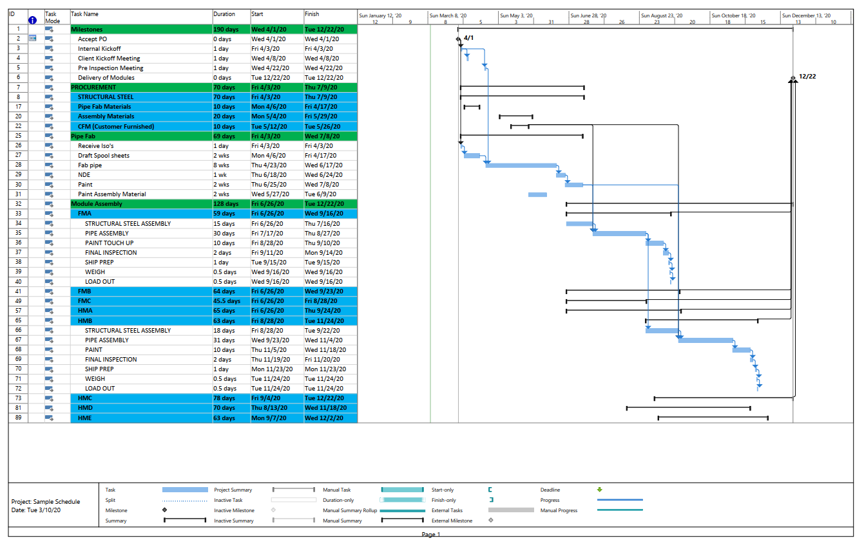
Standard Assembly Cycle

Slide 13
Benefits of Modularization at Shop
Controlled environment with 24/7 production ability
Improved quality
Schedule assurance
Dimensional Control
Marshaling at shop for JIT
Flexibility for change management
Repeatable design reduces engineering costs
Notes:
Shops should have available stabilized land for dimensional verification and storage of completed systems (if required).

Slide 14
Benefits of Modularization Realized at Job Site
Reduced craft and services- mechanical, I&E, structural, inspection.
Reduced housing and per diem at remote locations
Reduced field subcontracts- NDE, crane rental, welding equipment.
Reduced safety risk, parking, training, orientation, parking, lunch areas
Schedule reduction

Slide 15
Construction Industry Institute Report “Industrial Modularization How to Optimize: How to Maximize” April 2013
CII Research team charged with making a case for optimum use of off site assembly.
Compared current conventional field work processes with all modular work processes.
307 page report and “tool box” to determine feasibility of modularization.
“ Five solution Elements” Details the assessment process to modularize.

Slide 16
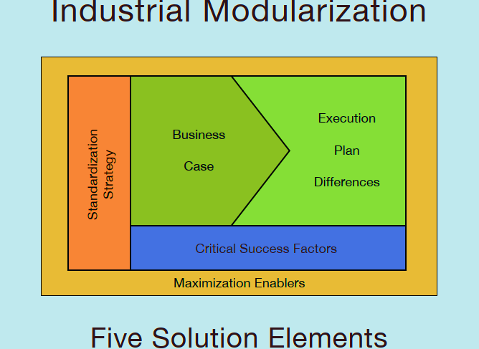
Construction Industry Institute (CII) Module Workshop

Slide 17
Five Solution Elements
Business case
Comparison of conventional field construction execution to modular construction execution.
Execution Plan Differences
Identify and Analyze Differences
Critical Success factors
Value drivers- cost, schedule, risk. Benefits realized from execution strategy
Standardization
Explores the case for standardization of systems for different industries
Maximize Enablers
Ten Key strategies to confront existing barriers for modularization

Slide 18
Thank You!

