Slide 1
Texas Extreme Weather and Climate Trends
John W. Nielsen-Gammon
Texas State Climatologist
Department of Atmospheric Sciences

Slide 2
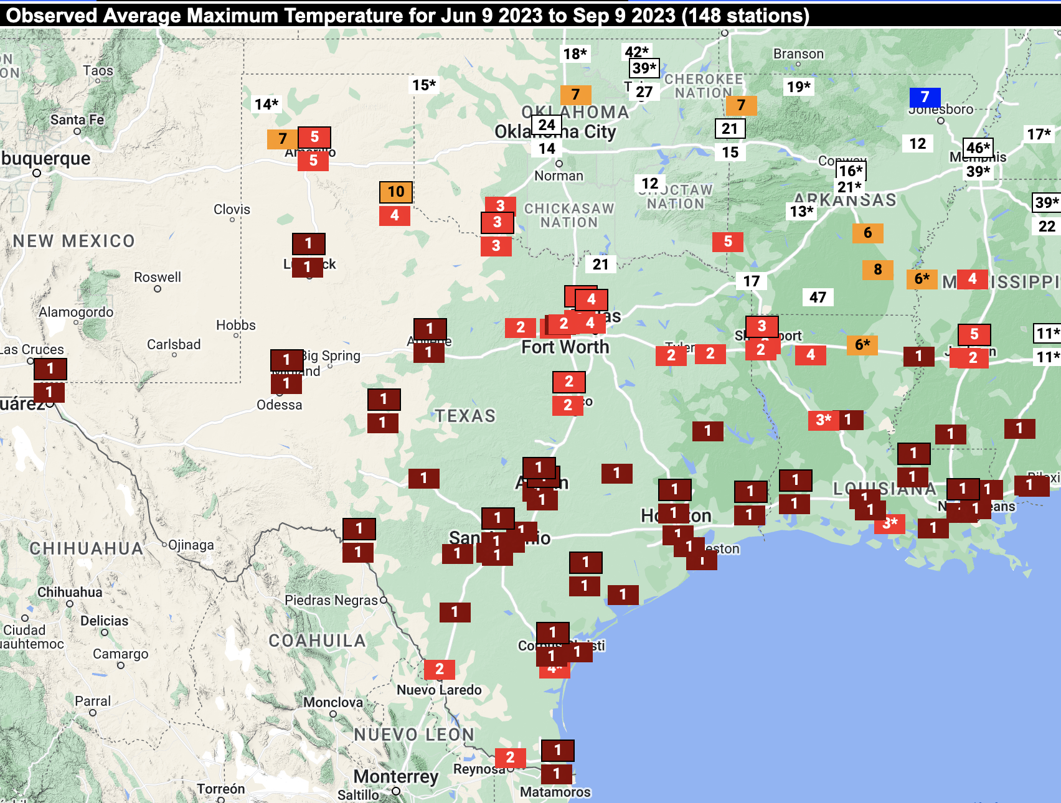
HOT

Slide 3
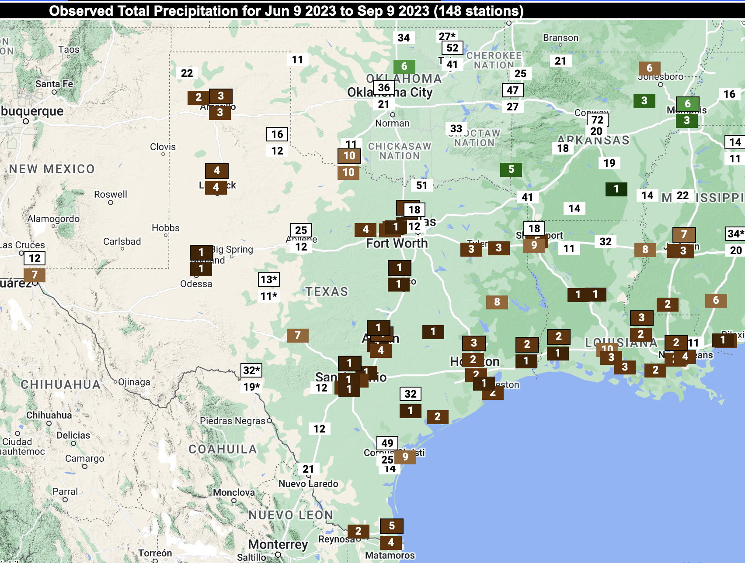
AND DRY
HOT

Slide 6
Future Climate
What will drive climate changes?
How much will that affect the global climate system?
What are the local consequences?

Slide 7
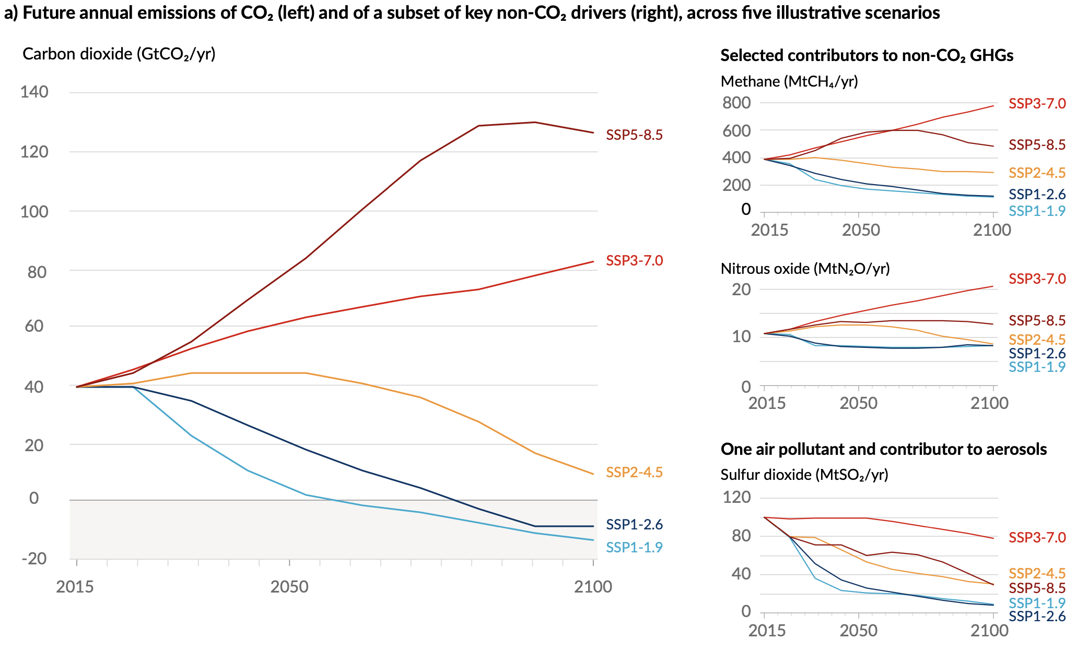

Slide 8
Future Climate
What will drive climate changes?
How much will that affect the global climate system?
What are the local consequences?

Slide 9
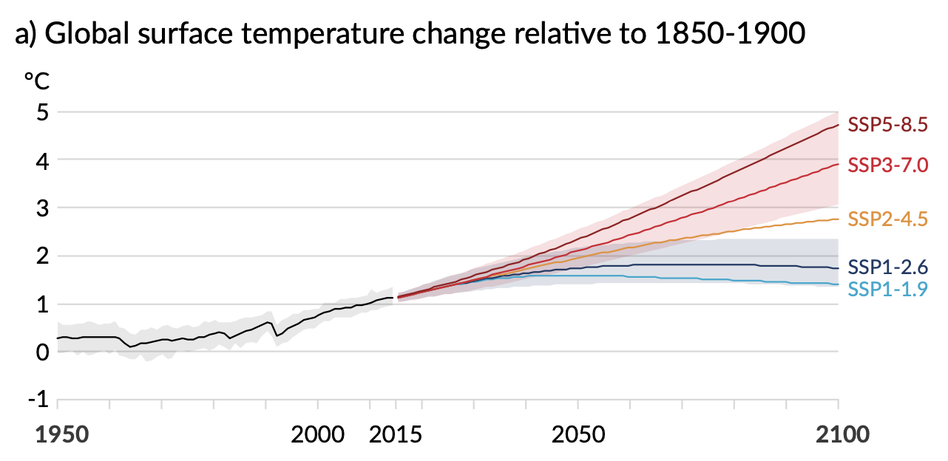

Slide 10
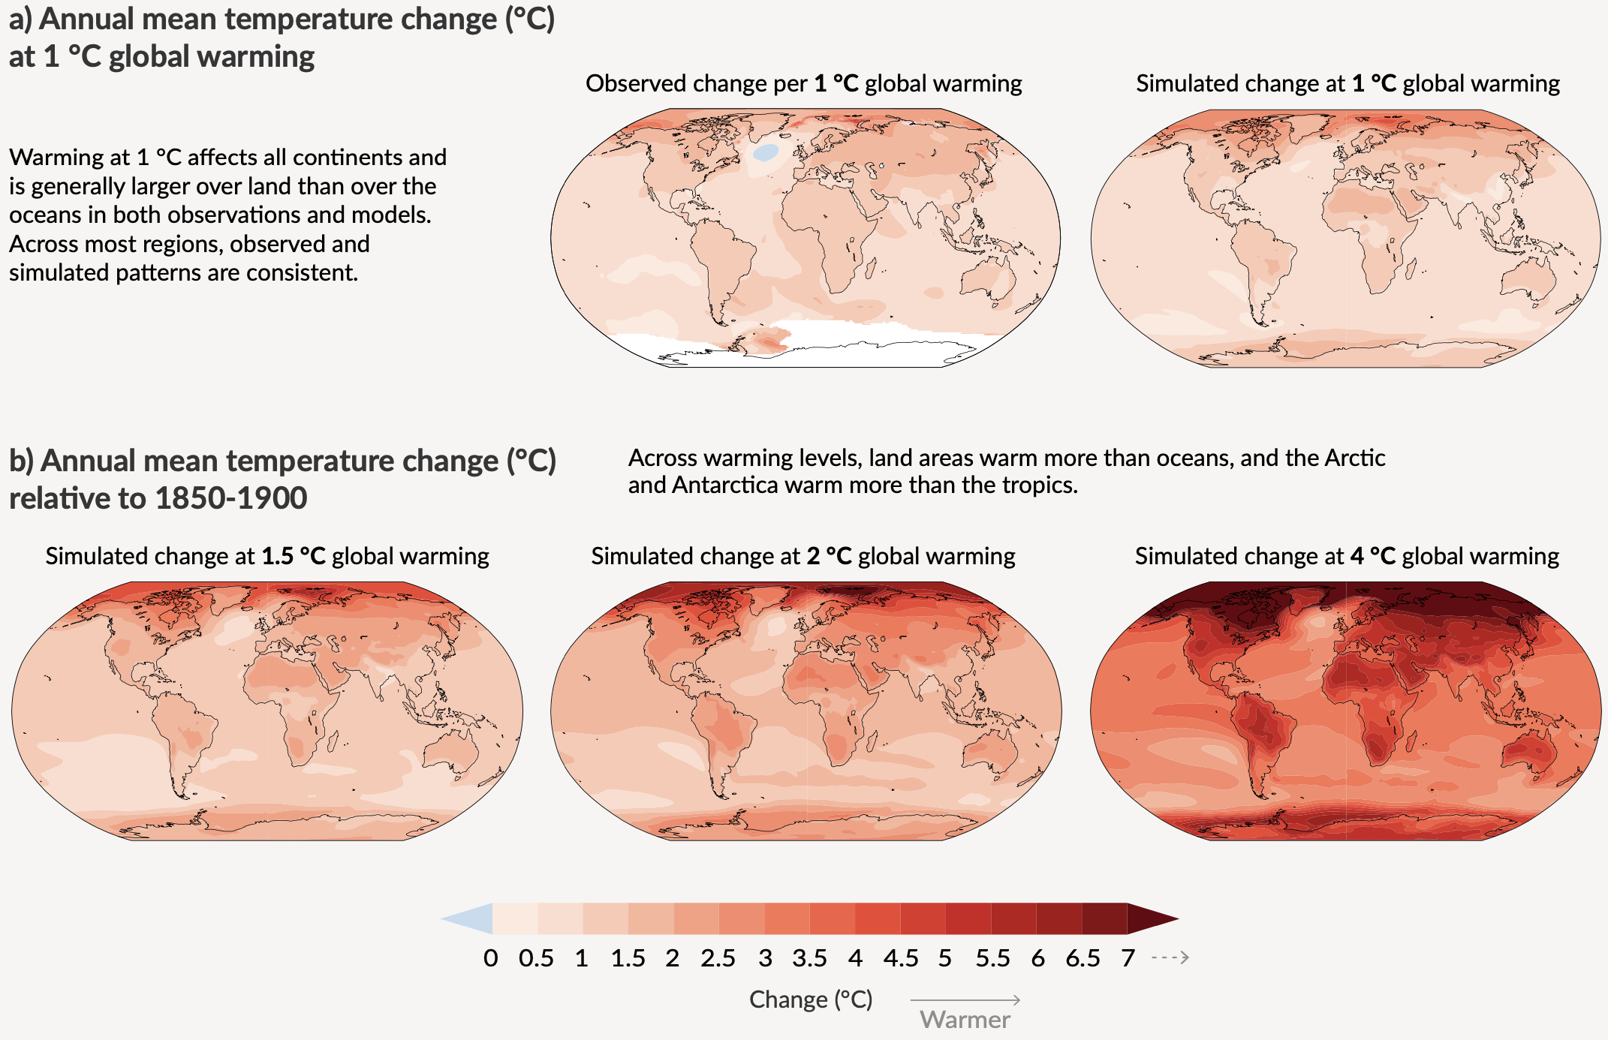

Slide 11
Future Climate
What will drive climate changes?
How much will that affect the global climate system?
What are the local consequences?

Slide 12
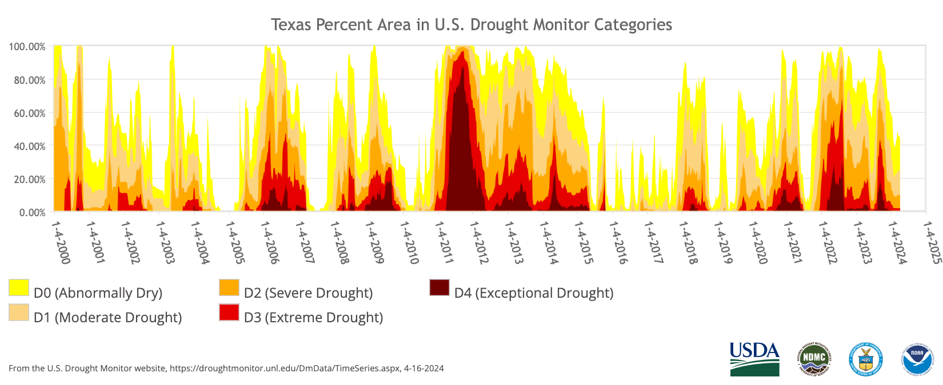
Drought in Texas, 2000-2024

Slide 13
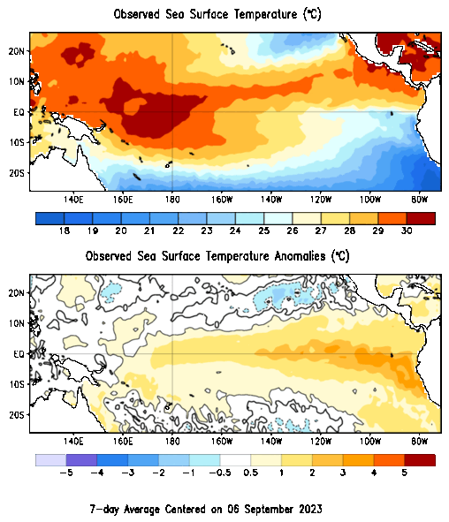
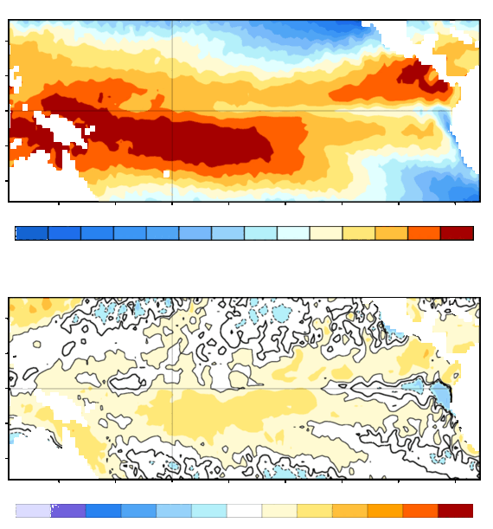
Latest 7-day average
www.cpc.ncep.noaa.gov

Slide 14
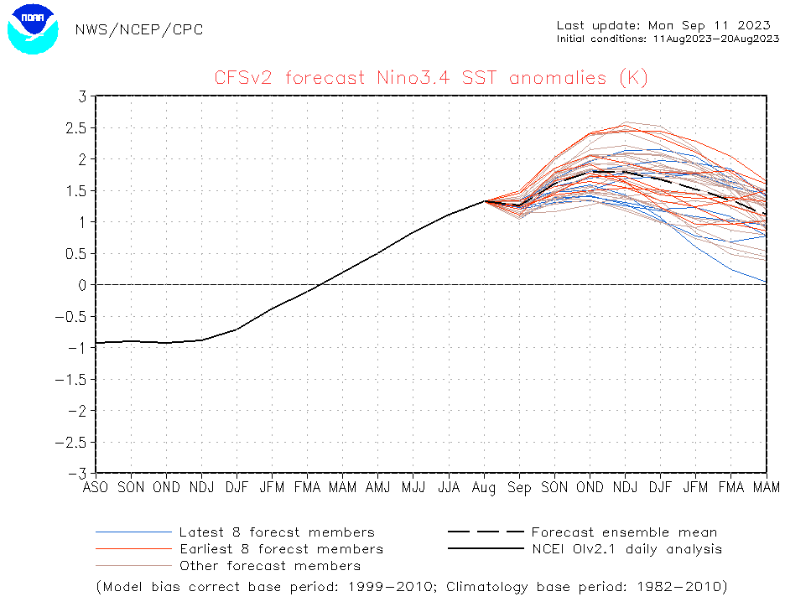
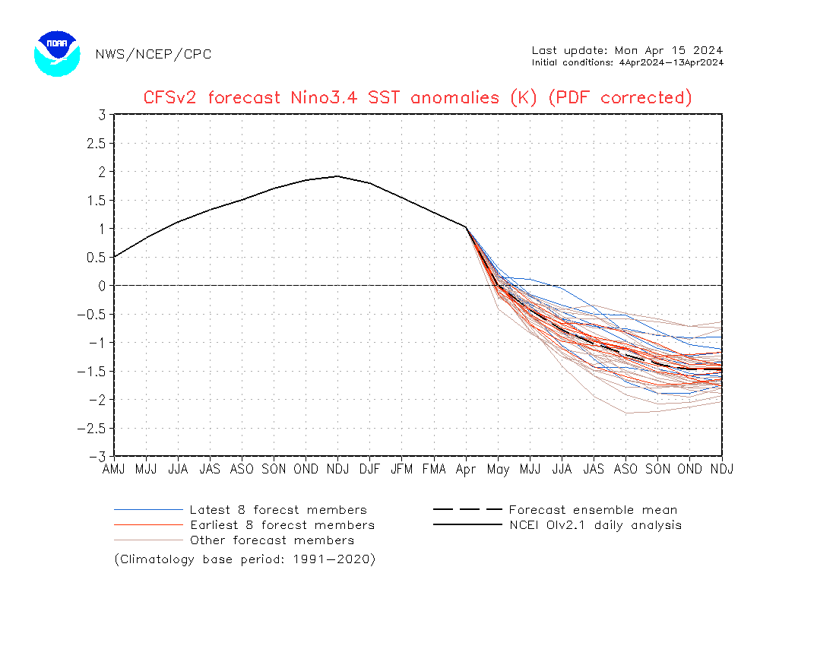
Latest

Slide 16
2021
2022
2011

Slide 17
2024
2021
2022
2011

Slide 18
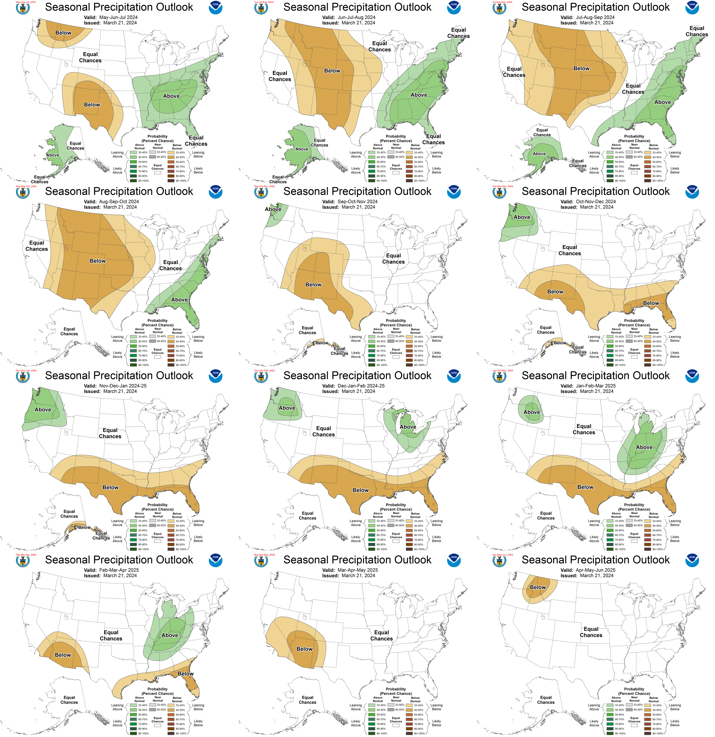

Slide 20
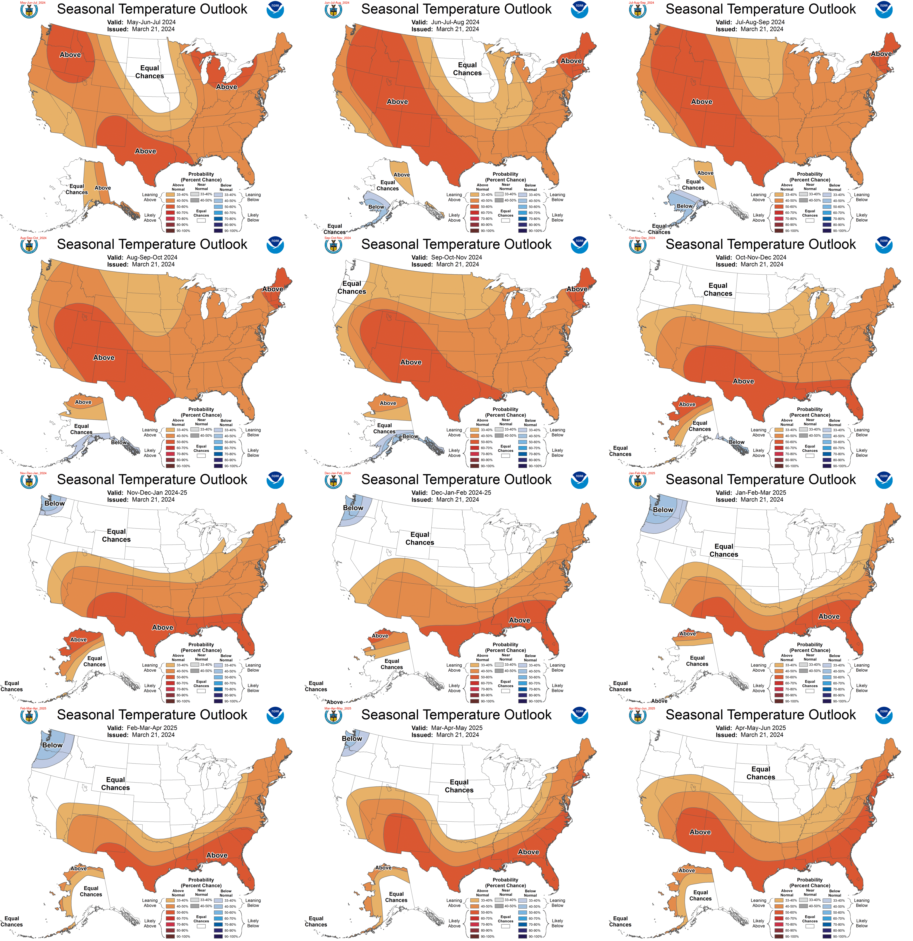

Slide 22
Climate Change and extreme weather
Thermodynamic effects
  Higher temperatures
  Greater moisture capacity in air
Dynamic effects
  Different weather patterns
  Different storm structures
Indicators of change
  Clear historical trend
  Consistent model projections
  Solid physical expectation
  Magnitudes line up

Slide 25
32
29
24
20
2011
16
12
1983
8
1951
2021
1930
4
1899
1989
0

Slide 26
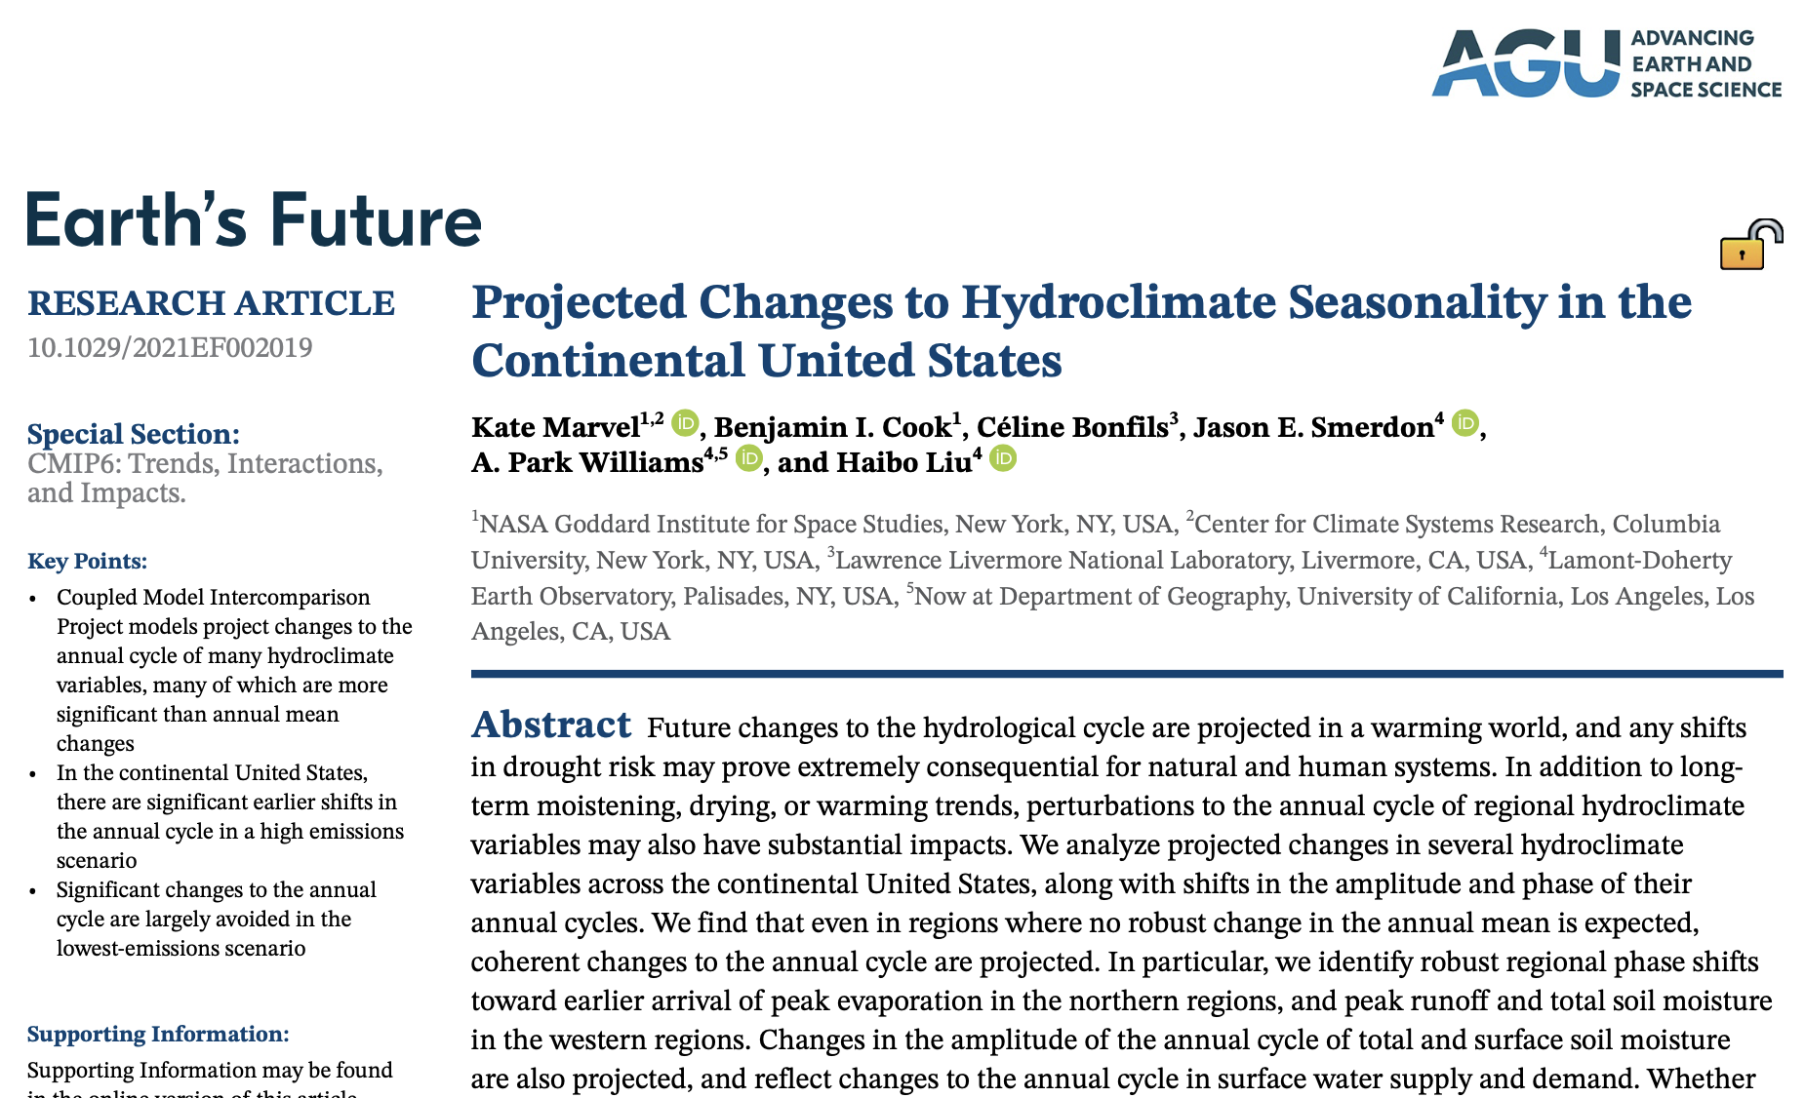

Slide 27
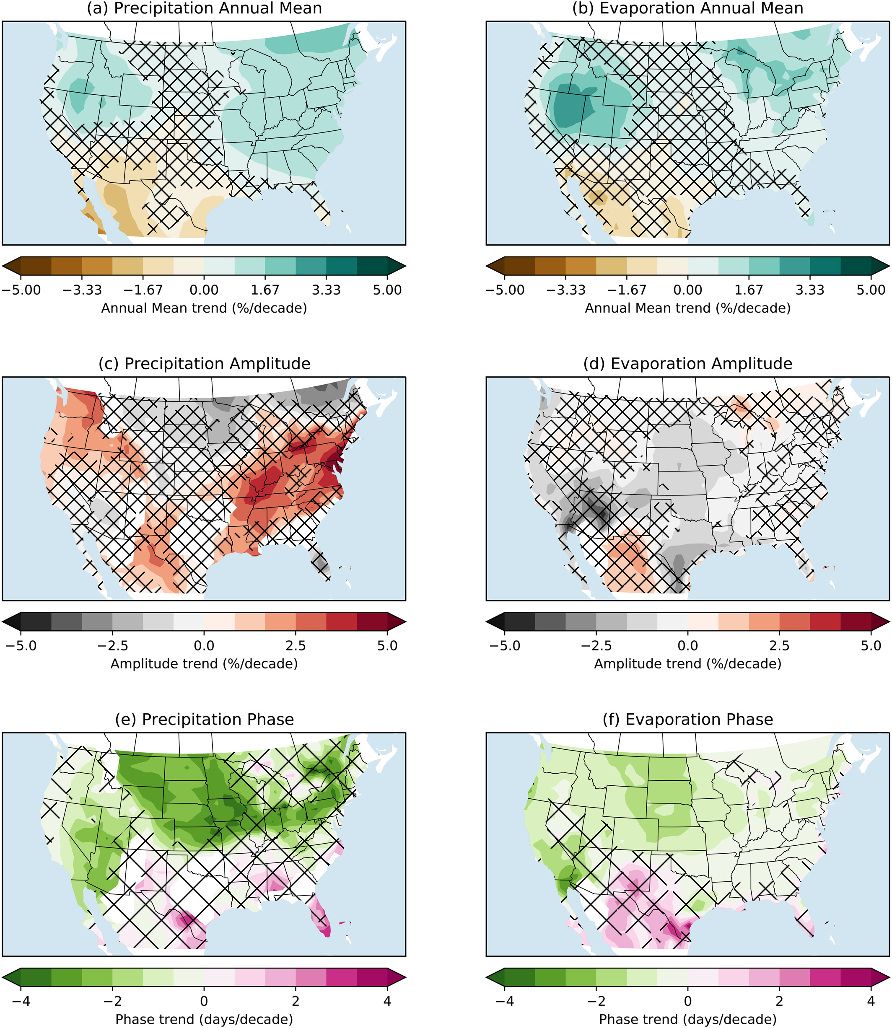
Hatching: at least 25% of models say one thing, at least 25% say another

Slide 28
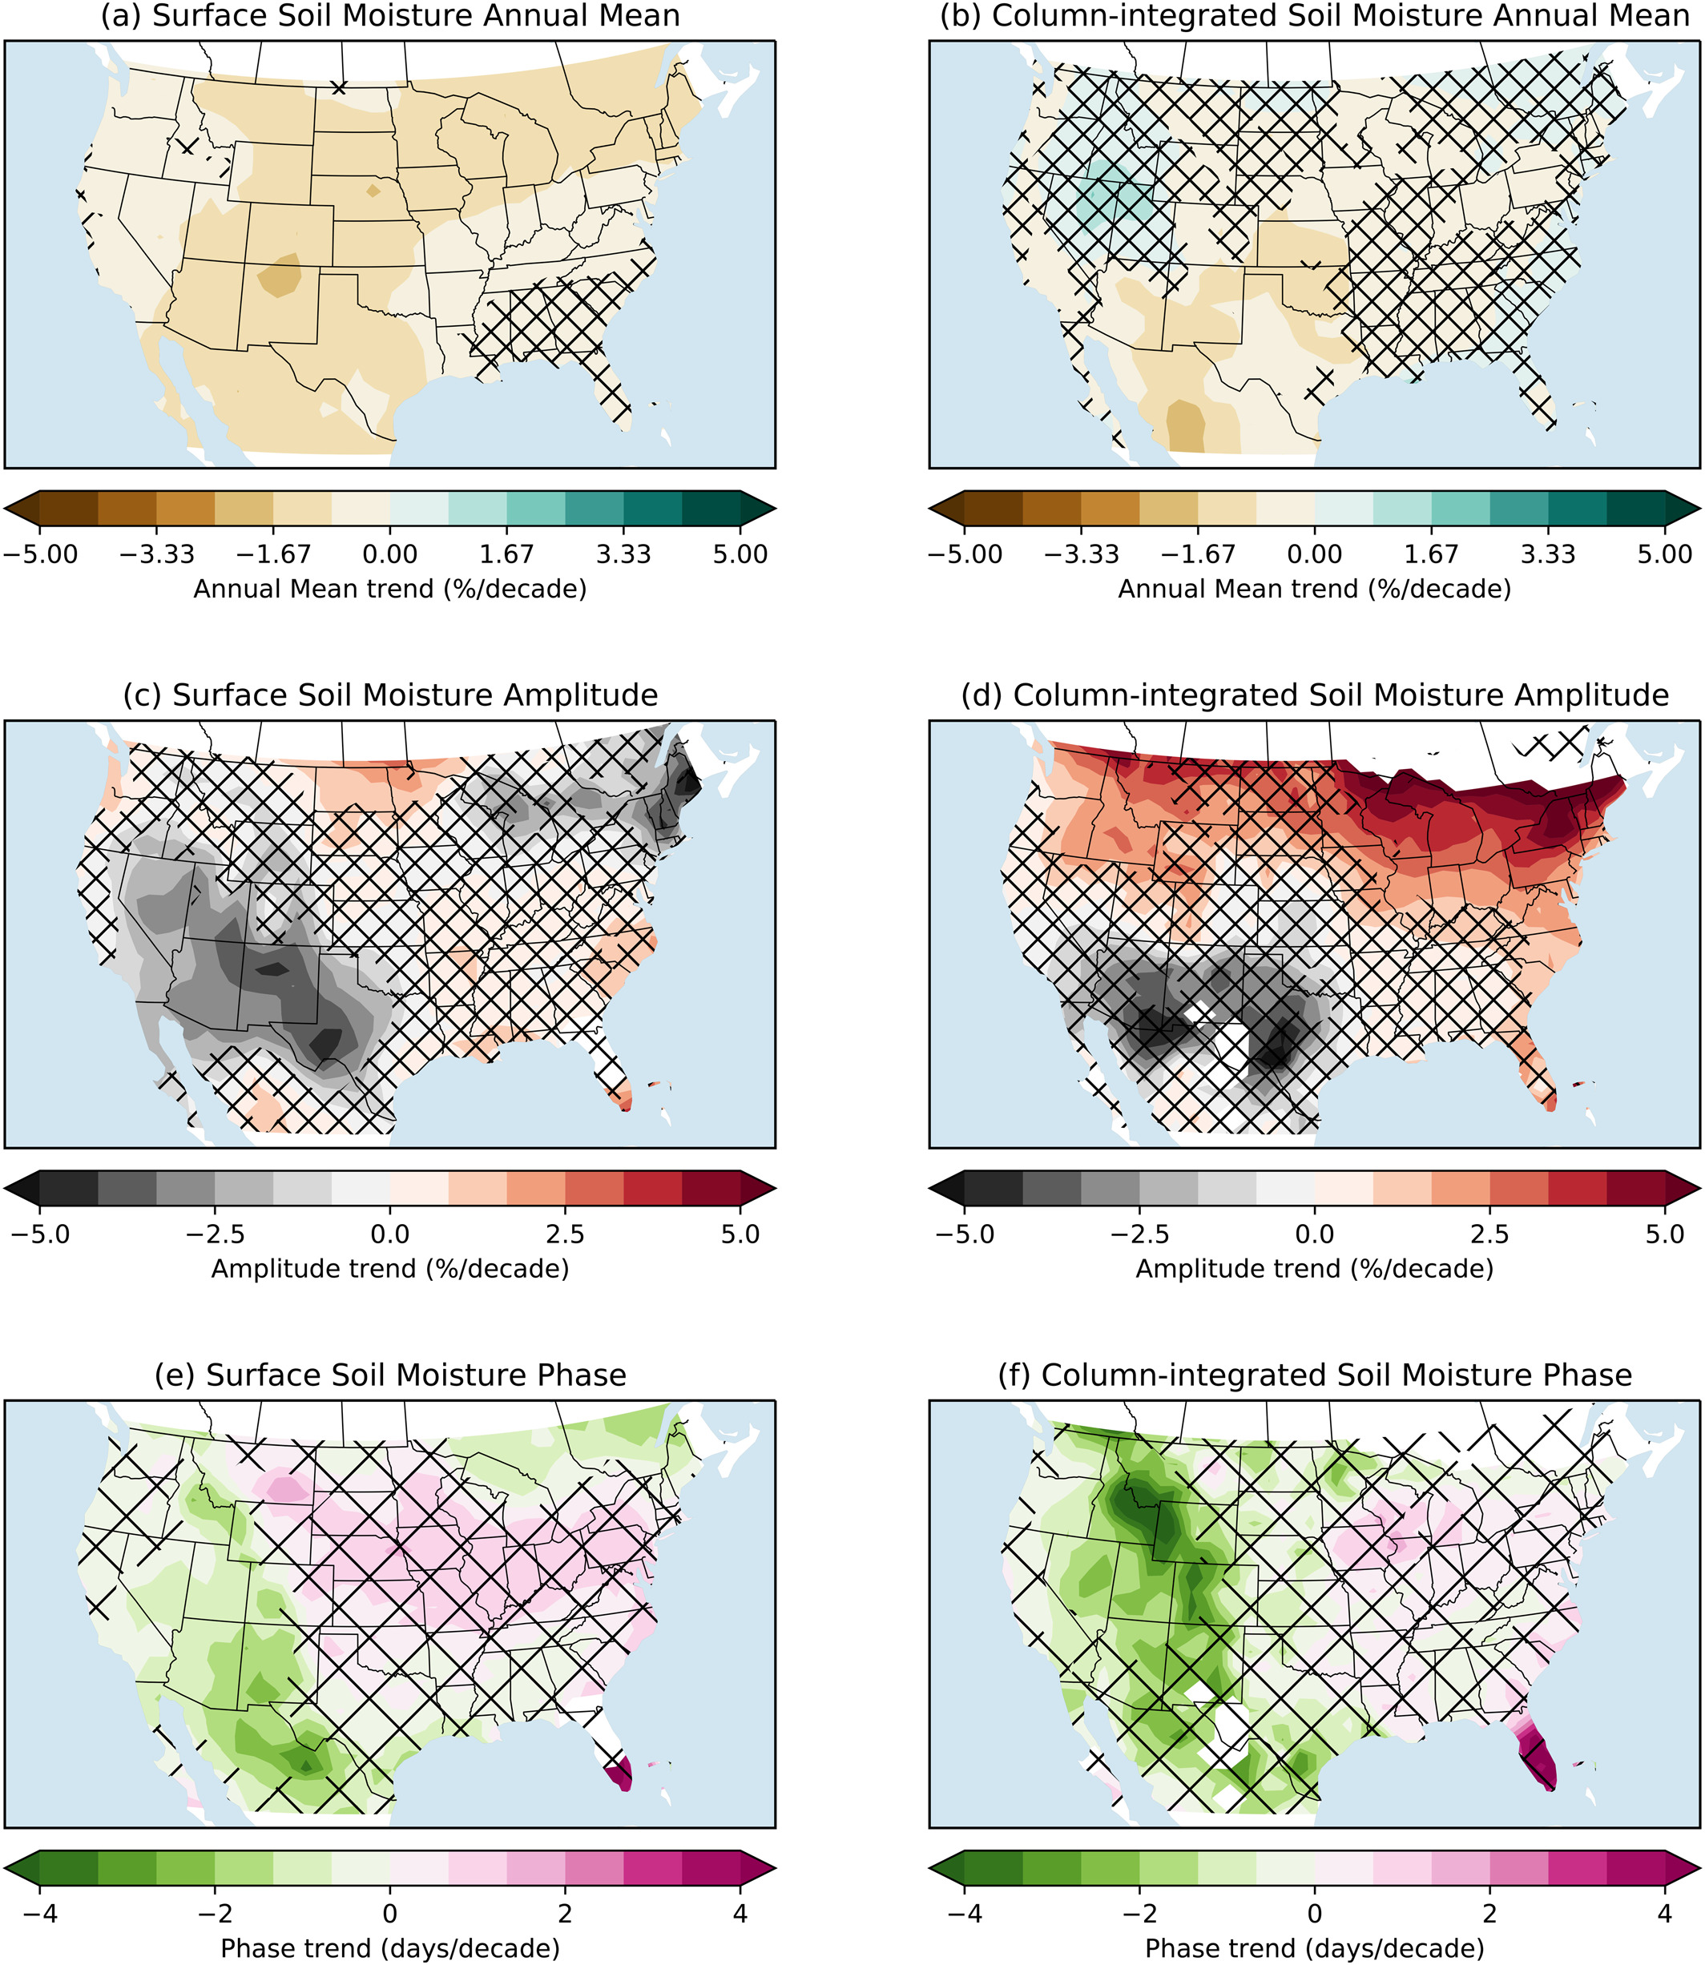

Slide 29
Impacts of reduced soil moisture
In one sense: more frequent and severe drought for agriculture
In another sense: climate shifts to the east
Agriculture must adapt (less water means less production)
  Plant physiological changes help somewhat
  Less due to climate change doesn’t mean less overall
Less aquifer recharge

Slide 30
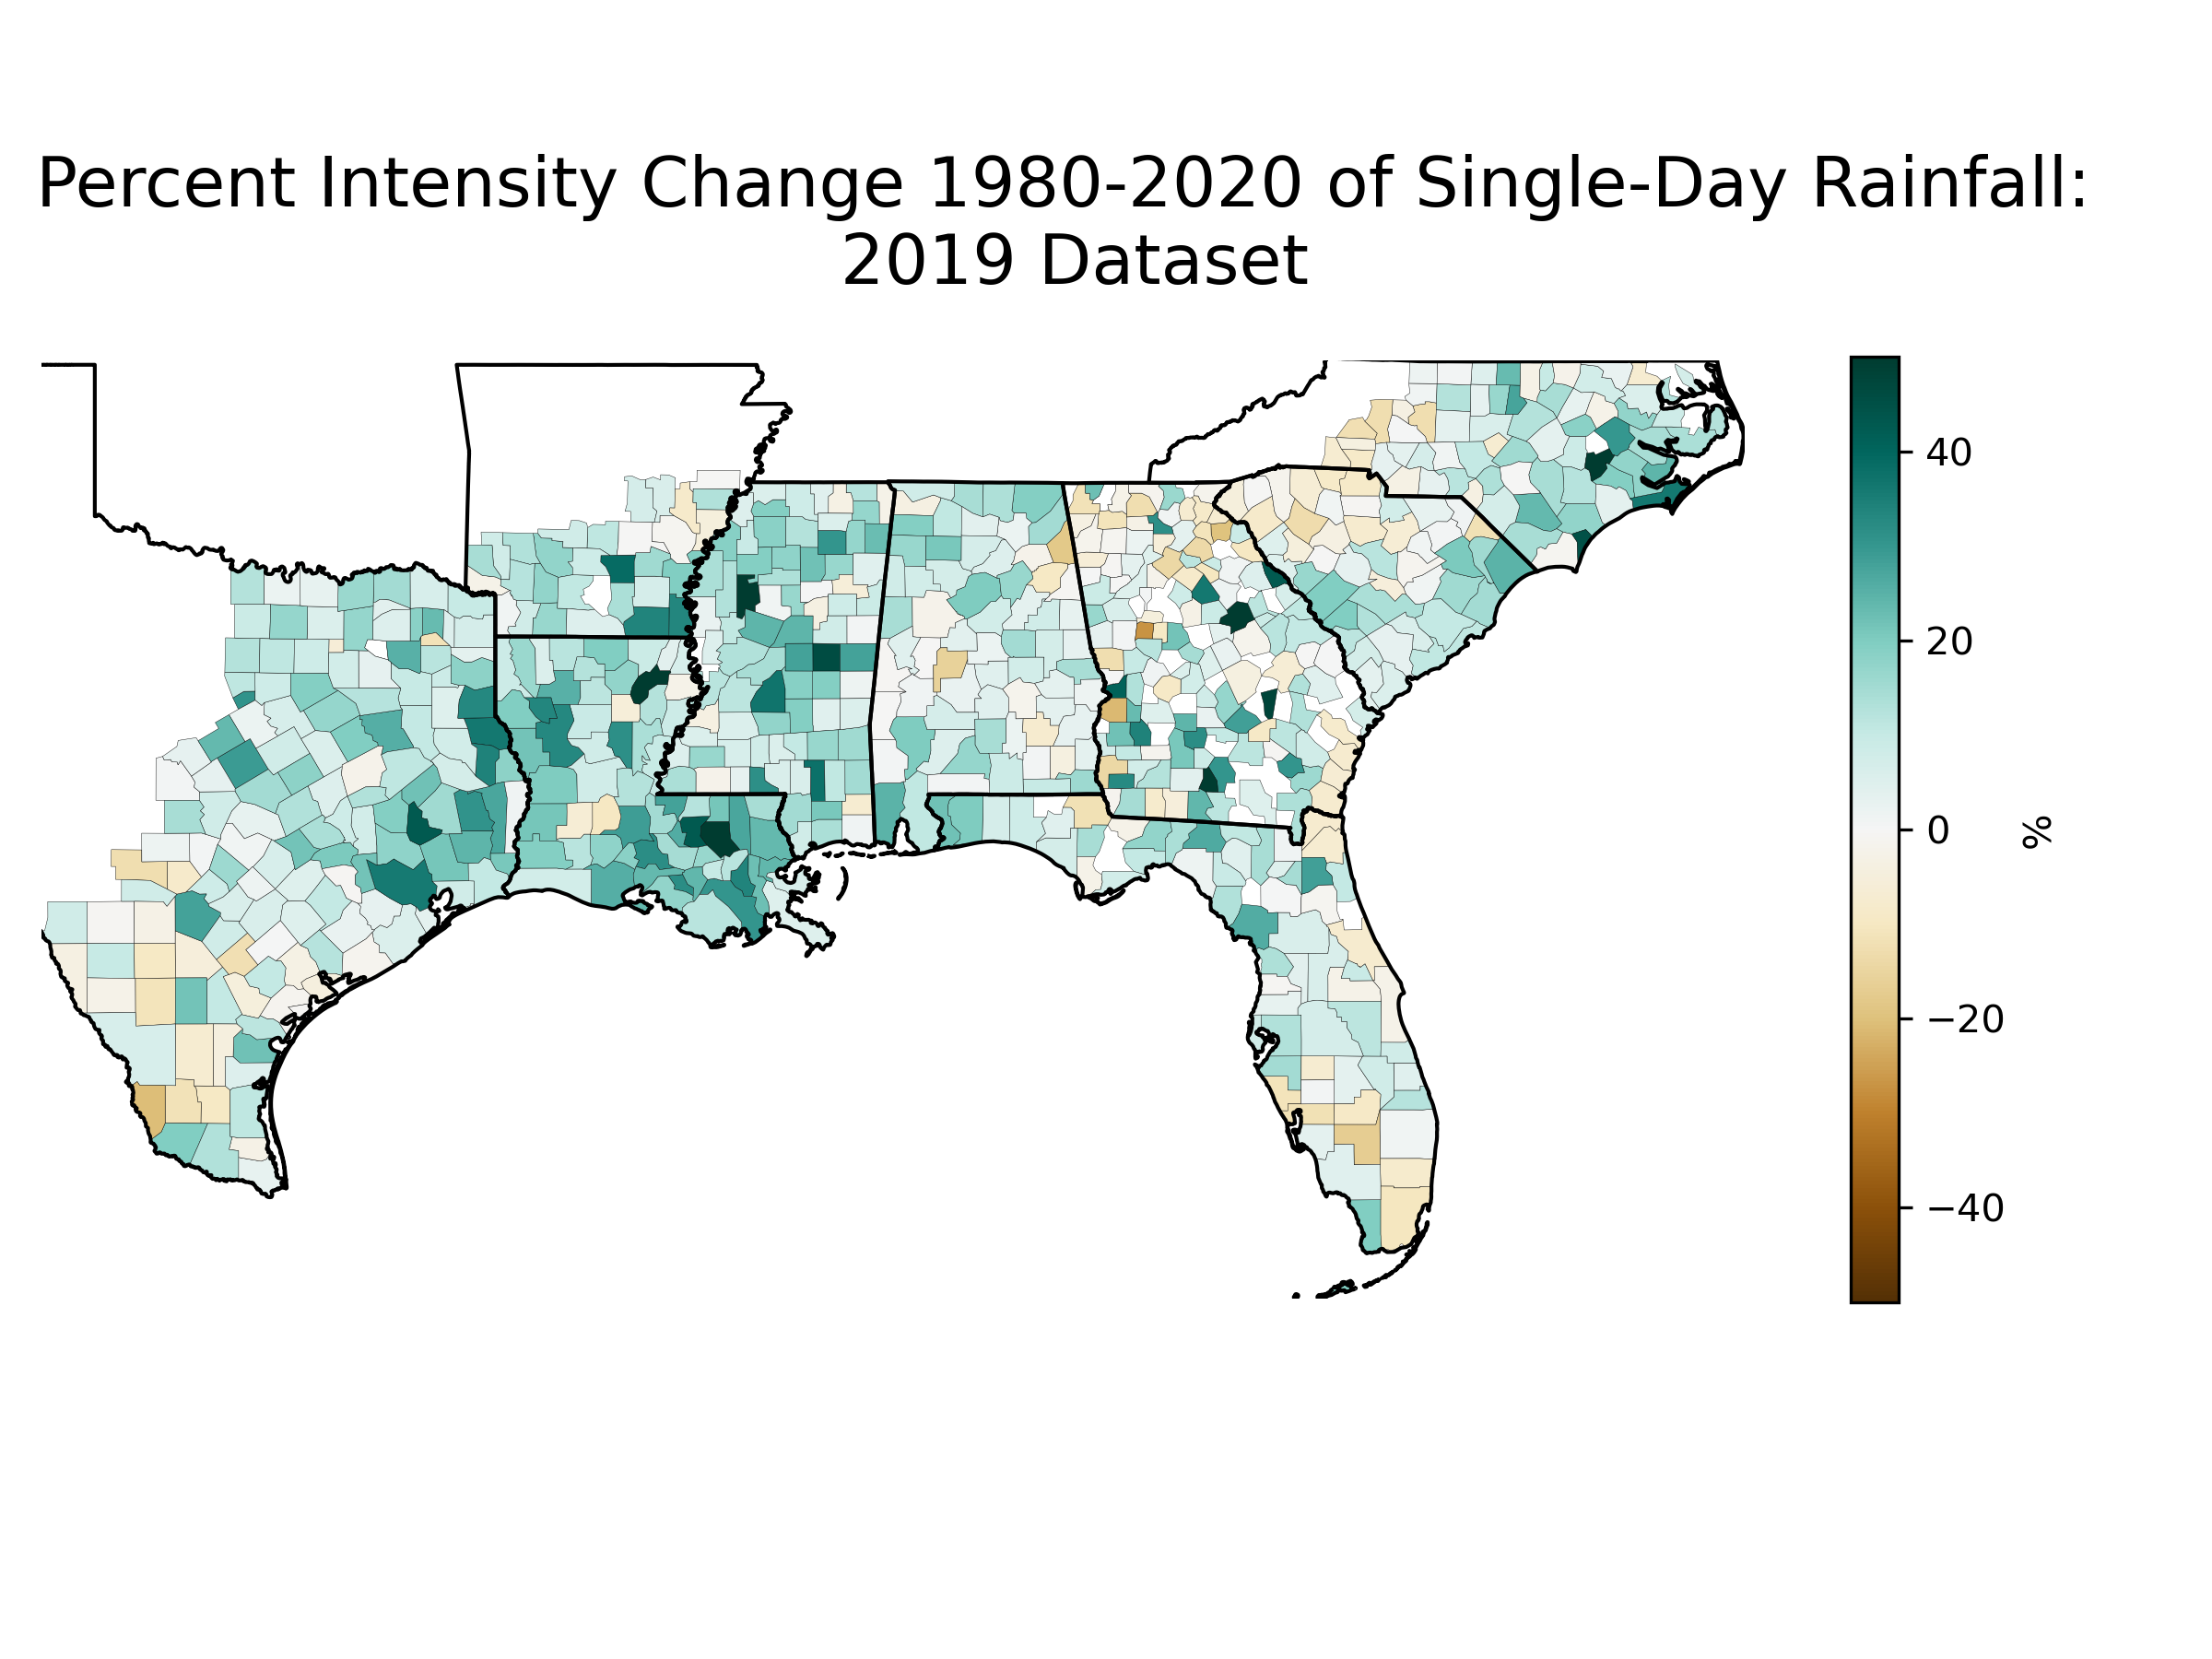
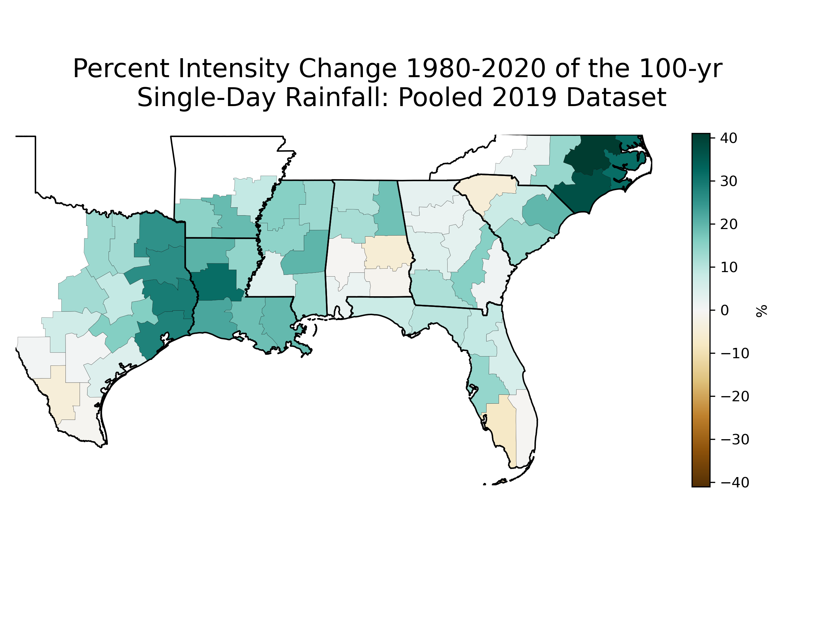
Extreme rainfall trends: 2020 vs. 1980

Slide 31
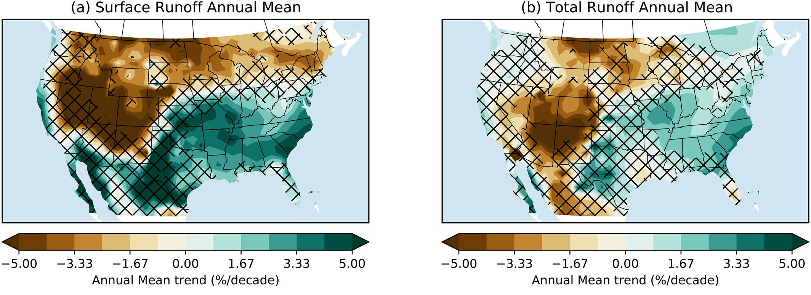

Slide 32
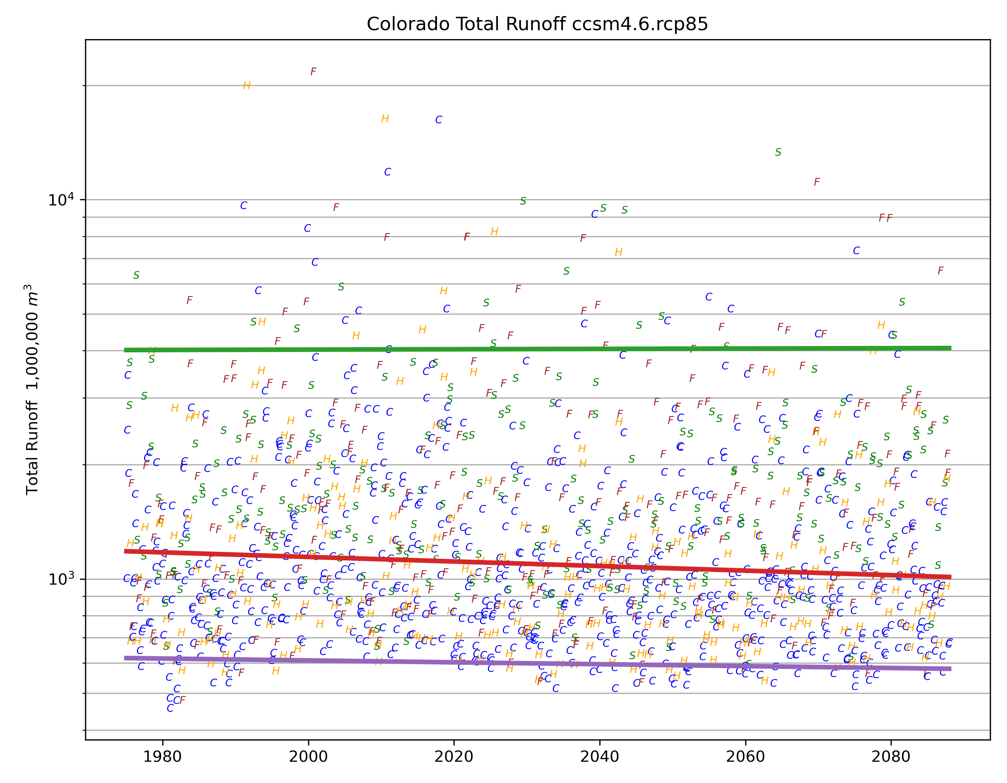

Slide 33
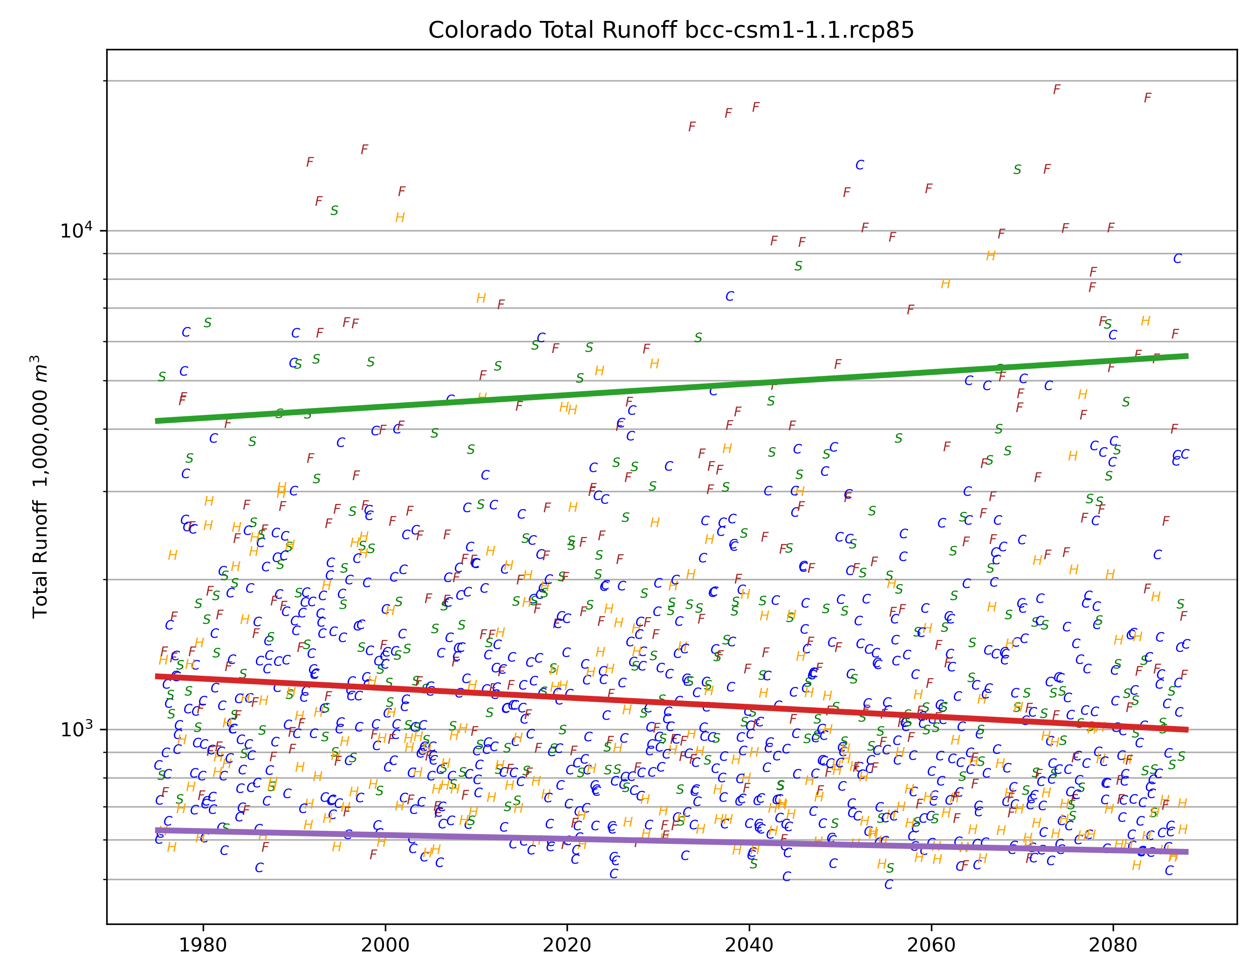

Slide 34
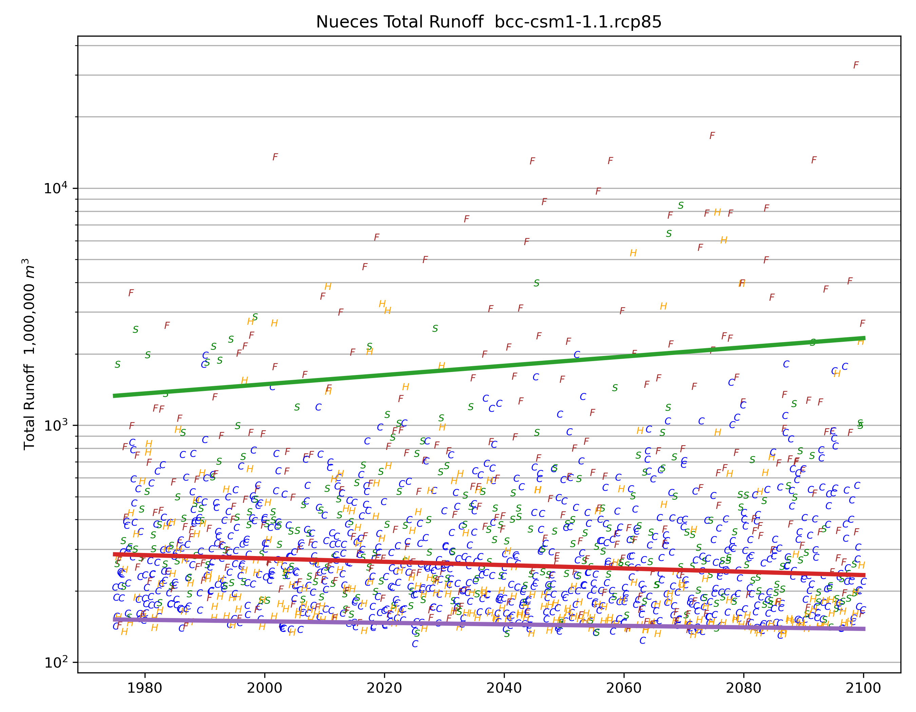

Slide 35
Climate change and water supply
Short droughts affect agriculture, long droughts affect water supply
Groundwater
  Reduced recharge
  Increased demand

Slide 36
Why more droughts? Or more aridity?
On the drying side…
  Changes in temperature
  Changes in rainfall extremes, month to month
On the wetting side…
  Changes in biosphere water use efficiency
On the unclear side…
  Changes in annual precipitation
  Changes in rainfall seasonality
  Changes in rainfall extremes, single storms
  Changes in biomass

Slide 37
Summary
Watch out for hurricanes and maybe hot summer #3
Climate trend toward increased rainfall variability, soil aridification
Not all extremes get worse
n-g@tamu.edu

