Slide 1
ADVANCES IN HYDROGRAPHIC SURVEYING* Houston Business Roundtable Forum - May 2013
Depth Sounding
Fusion with Above-Water LIDAR
Sidescan Sonar
Imaging Sonar
Sub-Bottom Profiling
*Shallow Water

Slide 2
Depth Sounding
Single Beam Sounders
Profiles only directly beneath transducer
Available in single (200Khz) and dual-frequency (~200kHz down to 24-40kHz)‏
Beamwidths from 3 to 8 degrees
28% bottom coverage with 50 foot line spacing
Multibeam Systems
Covers swath up to 2.5 to 6 times water depth
Produces terrain model down to 2ft x 2ft grid over area surveyed
Can see under some vessels and docks
200kHz to 450 kHz operating frequencies
Requires motion and heading sensors
Currently 1.5 to 2 times price of single beam survey
100% Bottom coverage

Slide 3
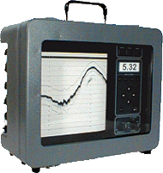
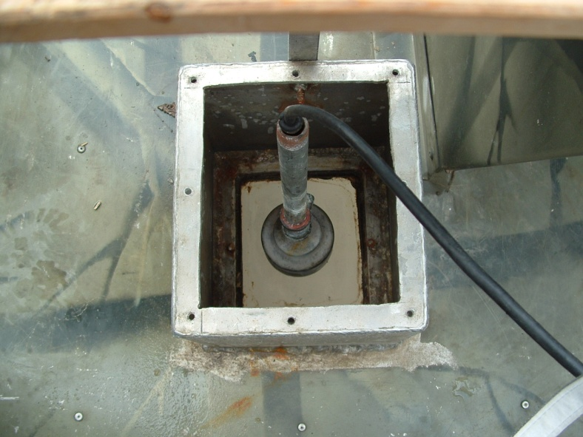
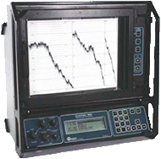
Single Beam Sonars

Slide 4
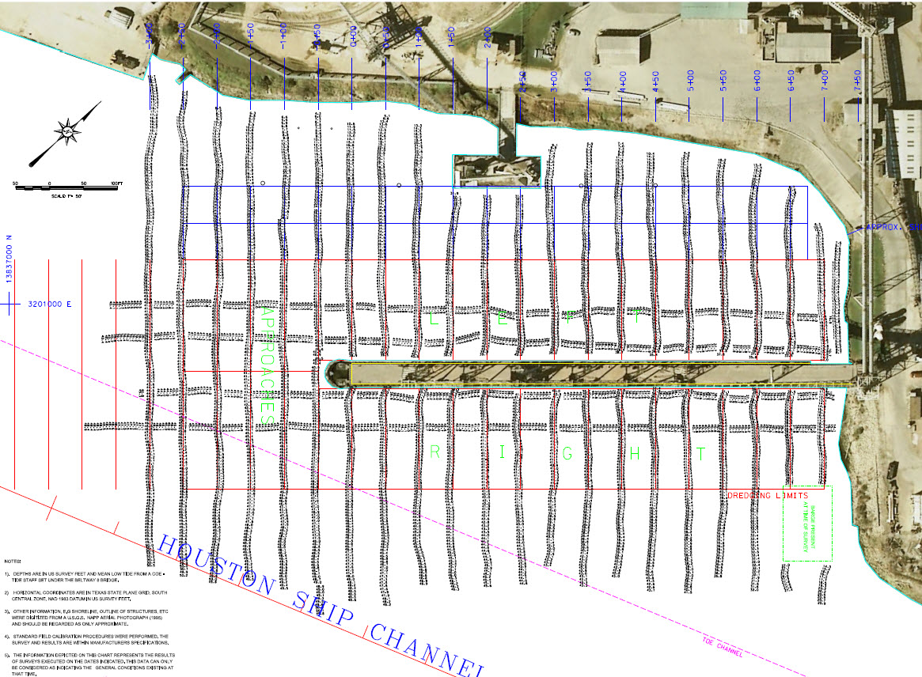
Examples of Data
Single Beam Depth Sounding

Slide 5
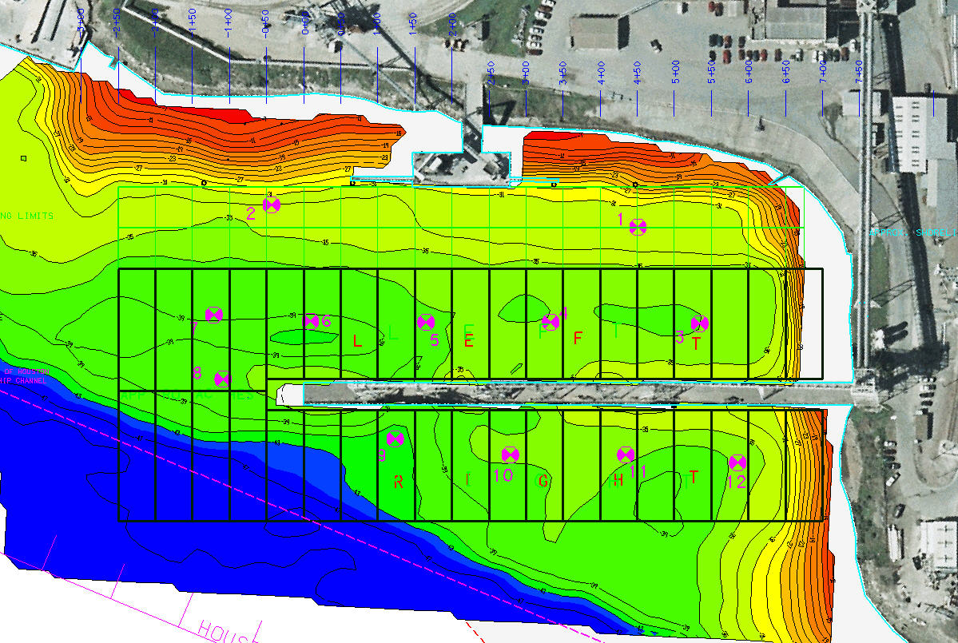
Examples of Data
Single Beam Depth Sounding

Slide 6
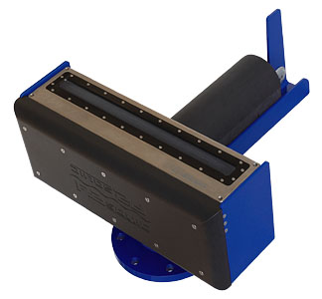
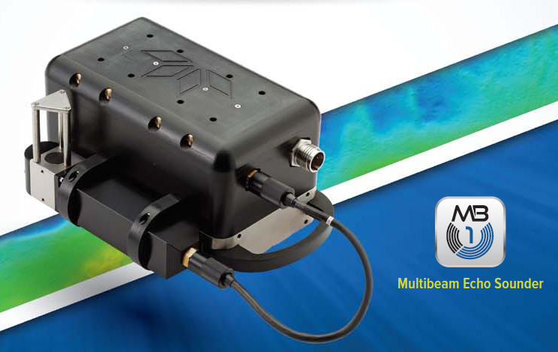
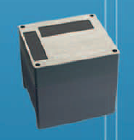
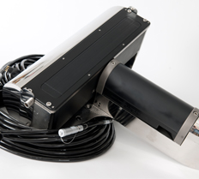
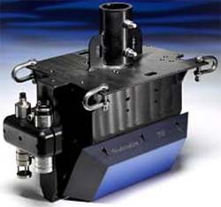
Multibeam Sonars
R2Sonic 2024
Odom MB-1
And new 2020
Reson 7125
Edgetech 4600
Swath/Sidescan
Geoacoustics
“Geoswath”

Slide 7
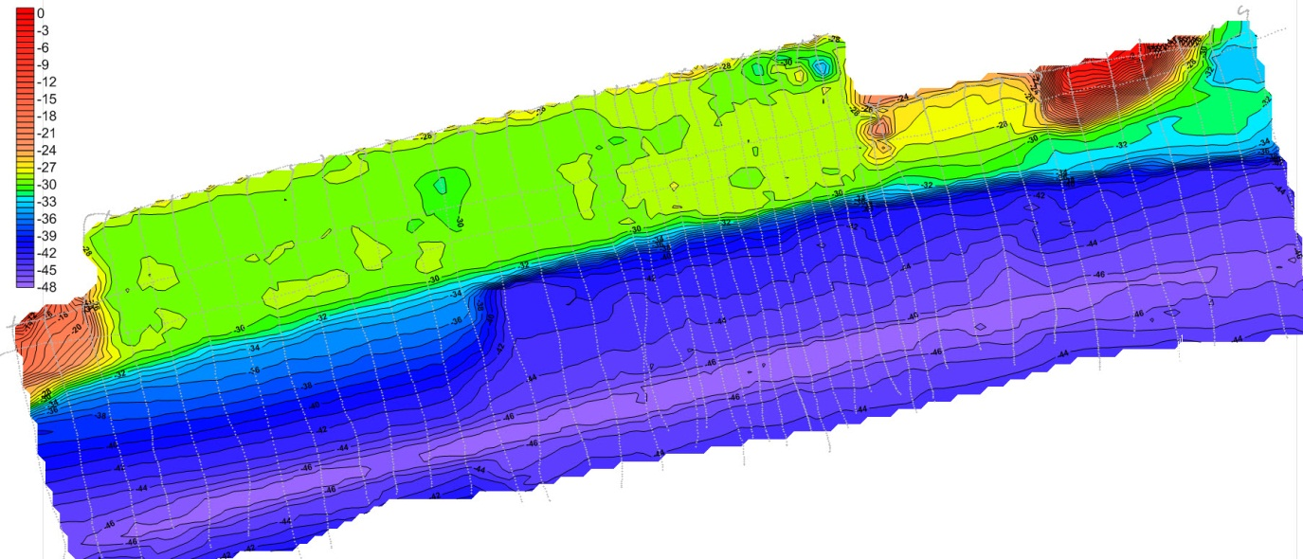
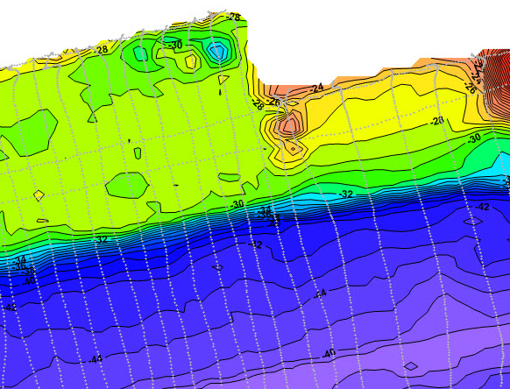
Examples of Data
Multibeam Survey
Multibeam Survey of Dock on the Houston Ship Channel

Slide 8
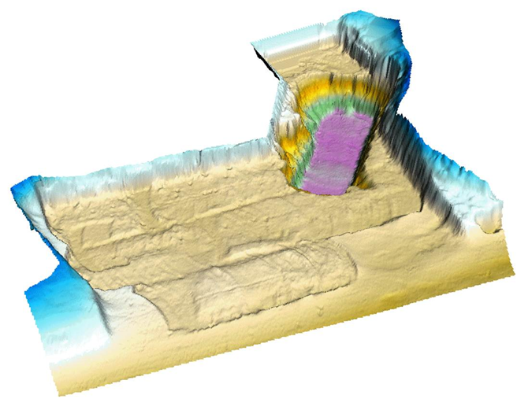
Examples of Data
Post-Dredge Multibeam Survey
Dredge “Cut”

Slide 9
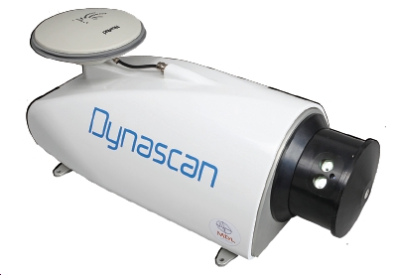
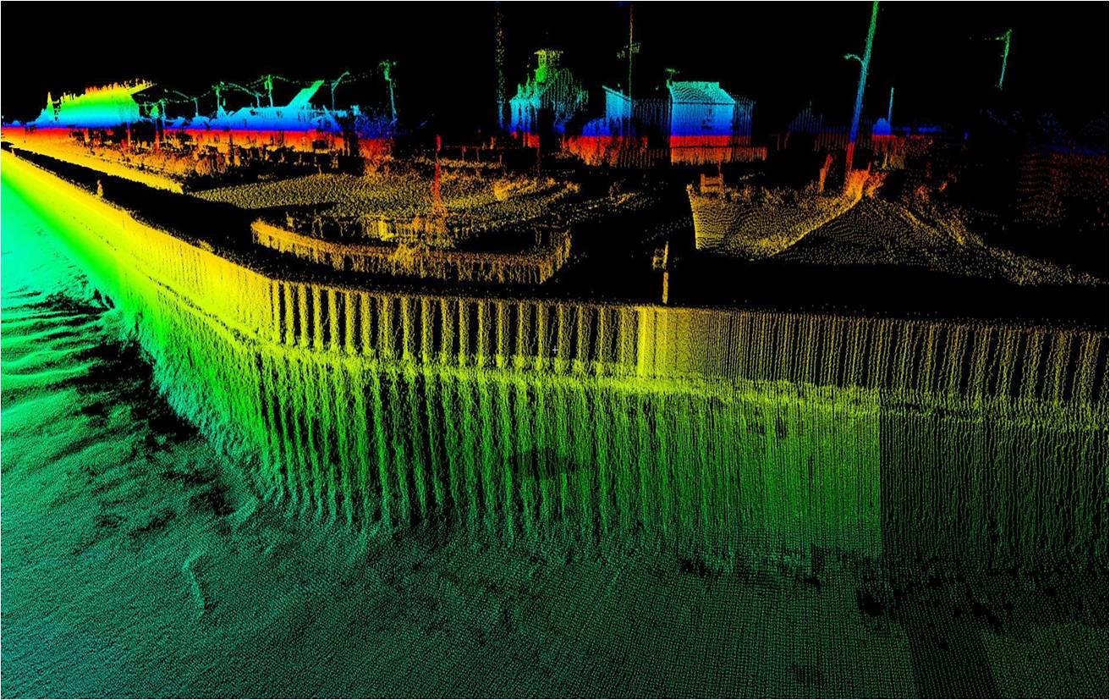
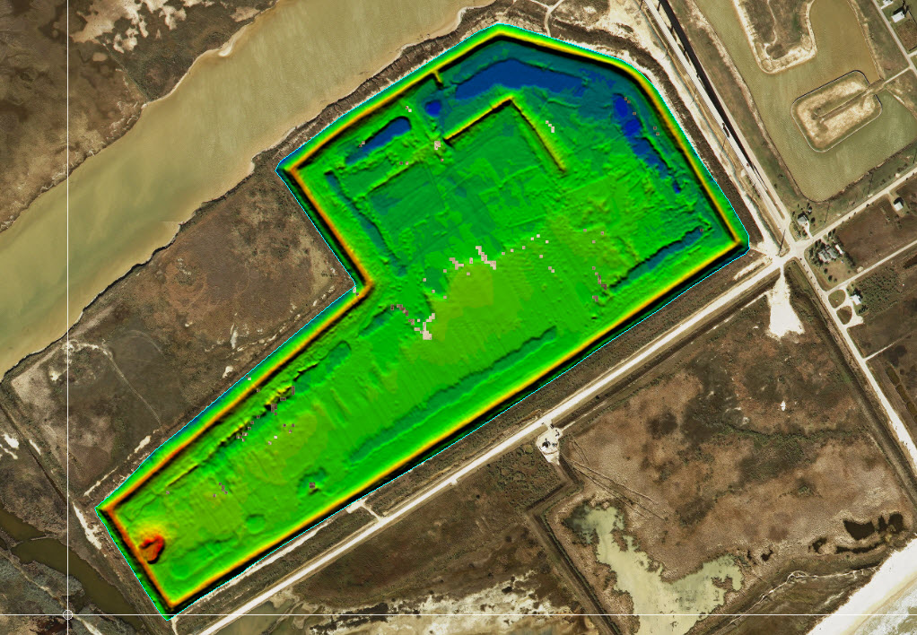
Examples of Data
Mobile LIDAR
LIDAR & Multibeam Depth Sounding
Onshore Disposal Area

Slide 10
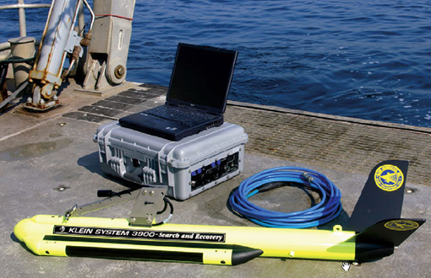
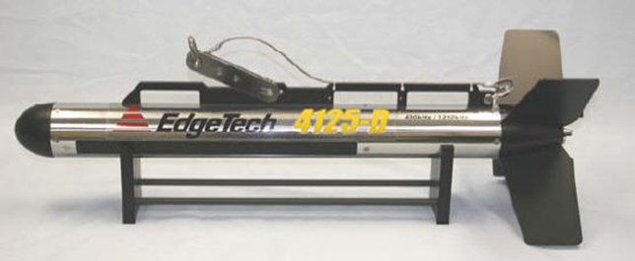
Sidescan Sonar
New dual (high) frequency Units
400/900 kHz
600/1600 kHz
All Digital
Chirp Technology
More sophisticated processing

Slide 11
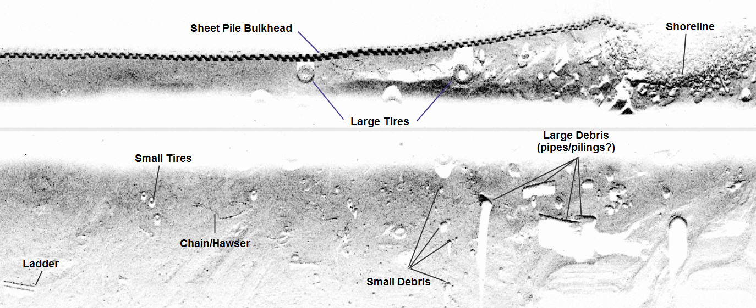
Examples of Data
Sidescan Sonar
Pre-Dredge Debris Survey - HSC

Slide 12
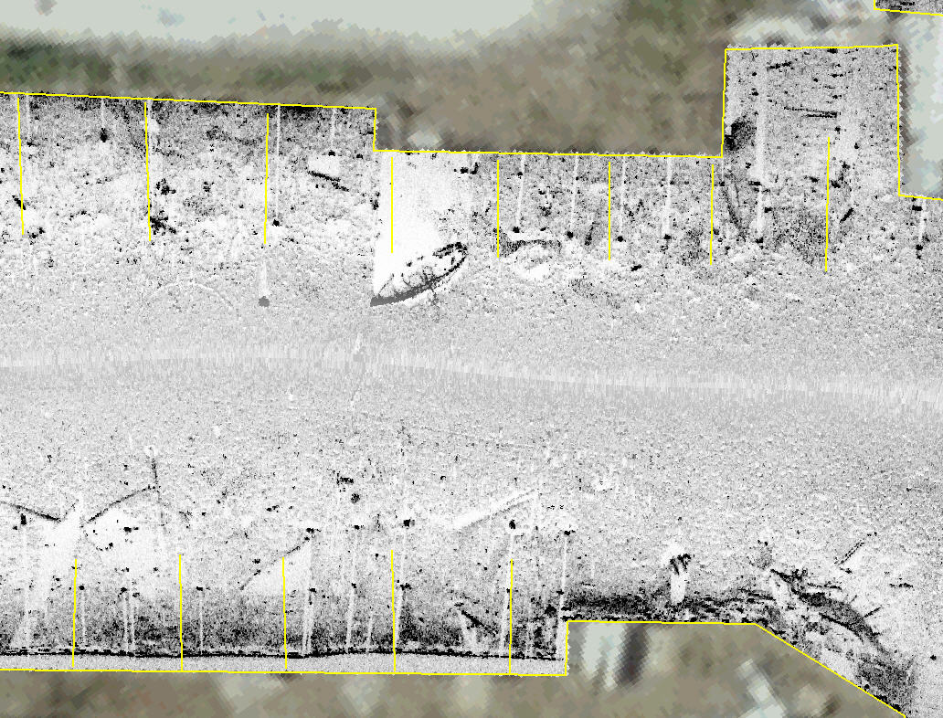
Post-Ike Survey of Marina, Pleasure Is. Port Arthur

Slide 13
Scanning Imaging Sonars
Mounted either on a pole over the side of a boat or on a tripod lowered to the sea bed.
Typically operates around 700 MHz but can go up to 1.35MHz and even 2.25 MHz.
Mechanically scanning sonar head
Limited coverage but very good resolution (no motion “smear”).
3-D “Multibeam” models now available

Slide 14
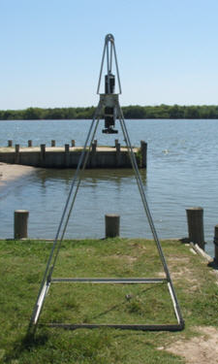
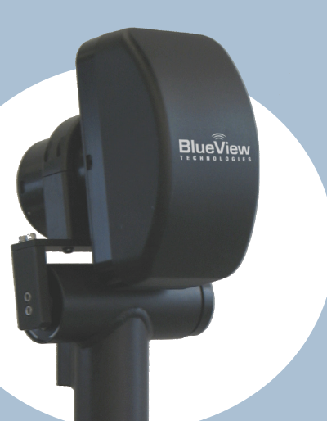
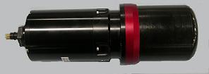
The BlueView BV5000 3-D mechanically scanning sonar head creates high resolution imagery of structures and objects and a 3-D point cloud that can be brought into CAD for modeling.
The Kongsberg Mesotech MS1000 series
1171 sonar head in a tripod.

Slide 15
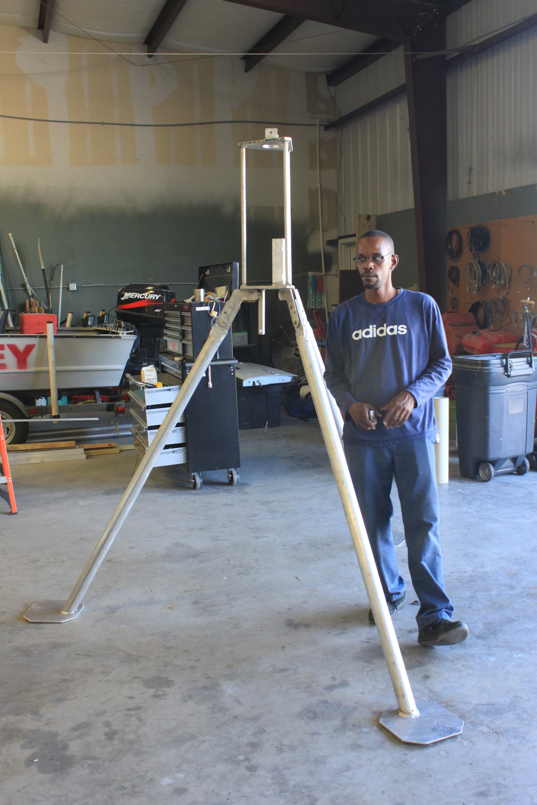
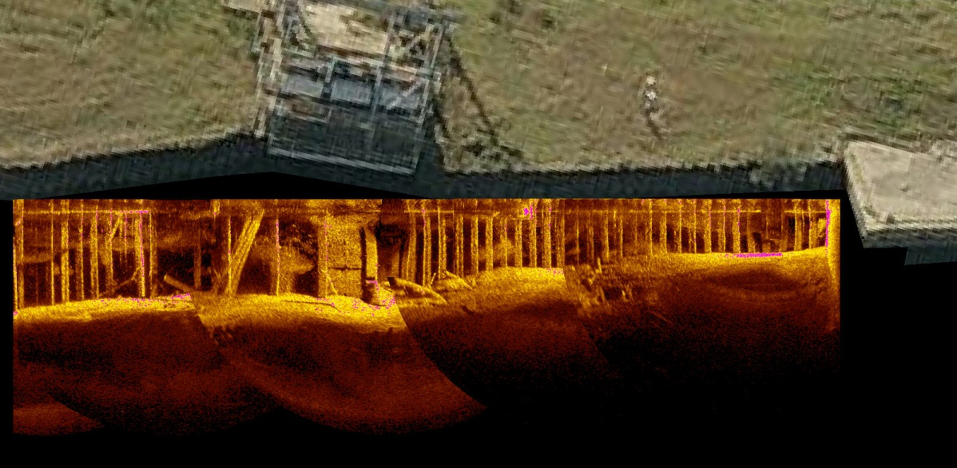
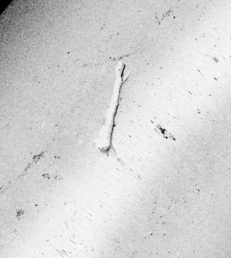
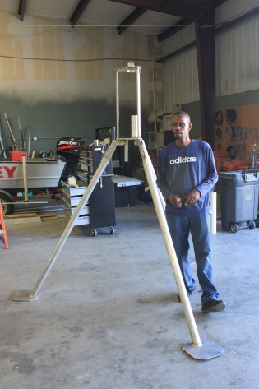
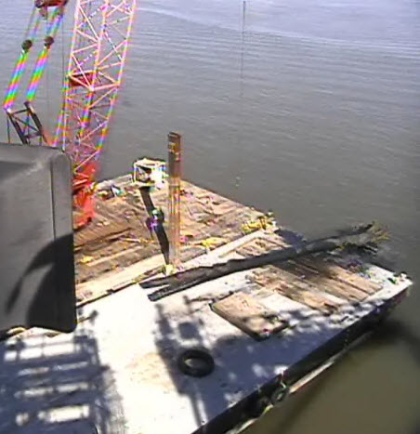
Examples of Data
Underwater Inspection
Post-Ike Debris Recovery

Slide 16
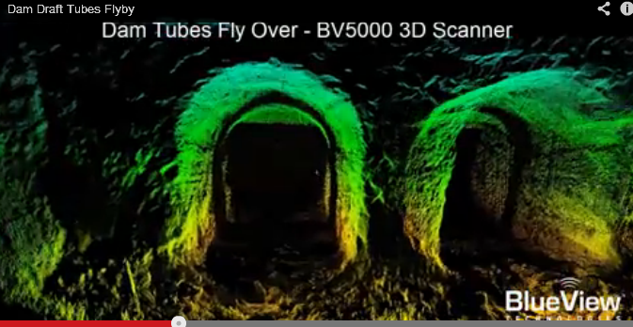
Examples of Data
Underwater Inspection

Slide 17
Sub-Bottom Profilers
High Frequency (3KHz to 20KHz)
Pingers – operate at 3.5 and 7-12 KHz. Output on graphic recorder. Self contained.
Chirps – work over a 10 MHz band. Computerized, very good resolution and slightly more penetration than the pingers. Can record data in several different formats on magneto-optical disk or DVD. Video and printer output. Interfaces to navigation computer for position data in data header and on fix marks.
Parametric systems – narrow beam formed by combination of low and high frequencies
Medium Frequency – (400 Hz to 1KHz) (Require a separately towed hydrophone cable)
Boomers – use an electrical pulse through two conducting plates to expand and collapse a rubber membrane. Typically record on paper with fix marks from a navigation computer.
Sparkers – look like a thick wiry toothbrush through which very high current is pulsed to create a large spark in the water. This liberates a gas bubble which implodes causing the acoustic wave. Usually records the same way as boomers.
Low Frequency (Low hundreds of Hz) – Require long hydrophone cable and large compressors
Water Guns – use high pressure water to create a vacuum in a chamber which is then opened to the sea as it implodes. Connected to sophisticated data recording system.
Air Guns – similar to water guns but use compressed air. Also used primarily for hydrocarbon exploration. Connected to sophisticated data recording system.
Sleeve Exploders – explodes propane gas in a thick rubber boot and causes a shockwave in the water. Was used for detecting relatively shallow gas pockets for locating hydrocarbons drill rigs. Connected to sophisticated data recording system.

Slide 18
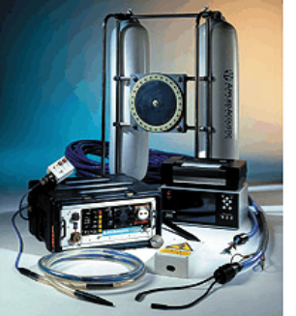
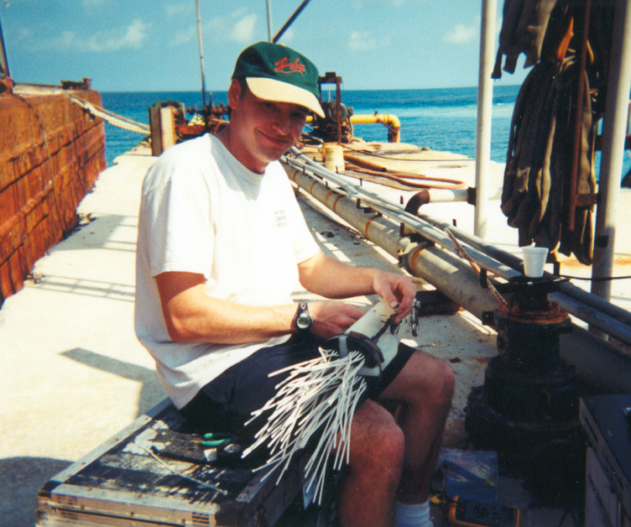
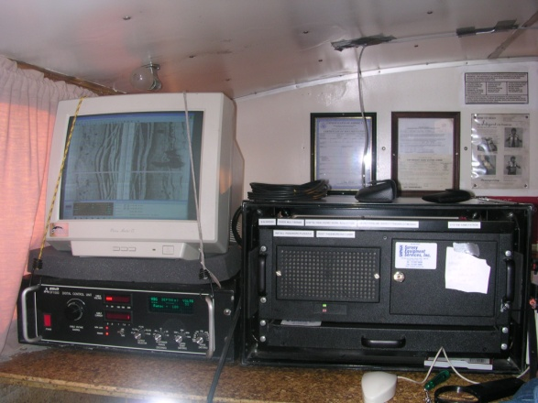
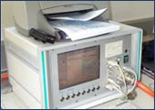
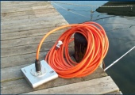
Sub-Bottom Profilers
Edgetech “Chirp” Fish
Applied Acoustics Boomer
Sparker
CODA Recording System
Innomar SES2000 Parametric Sonar

Slide 19
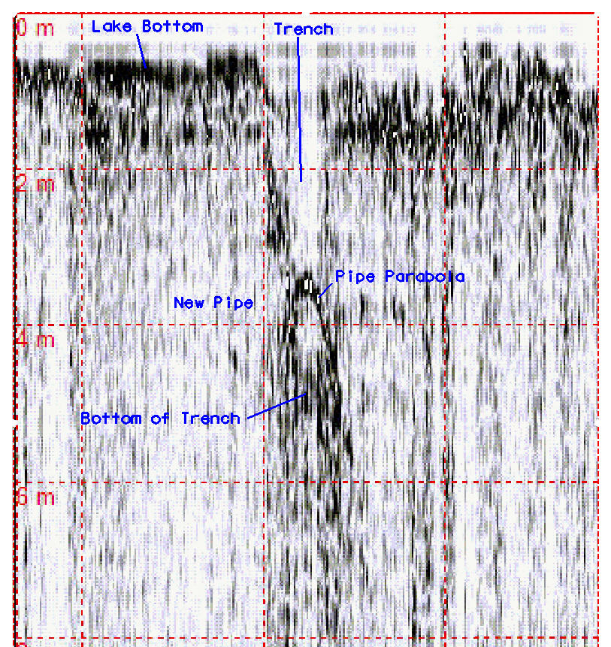
Examples of Data
Sub-Bottom Profiler
Sea Bed
Sand
Carbonate Rock
Pipeline Location
Geology for New Channel - Bahamas

Slide 20
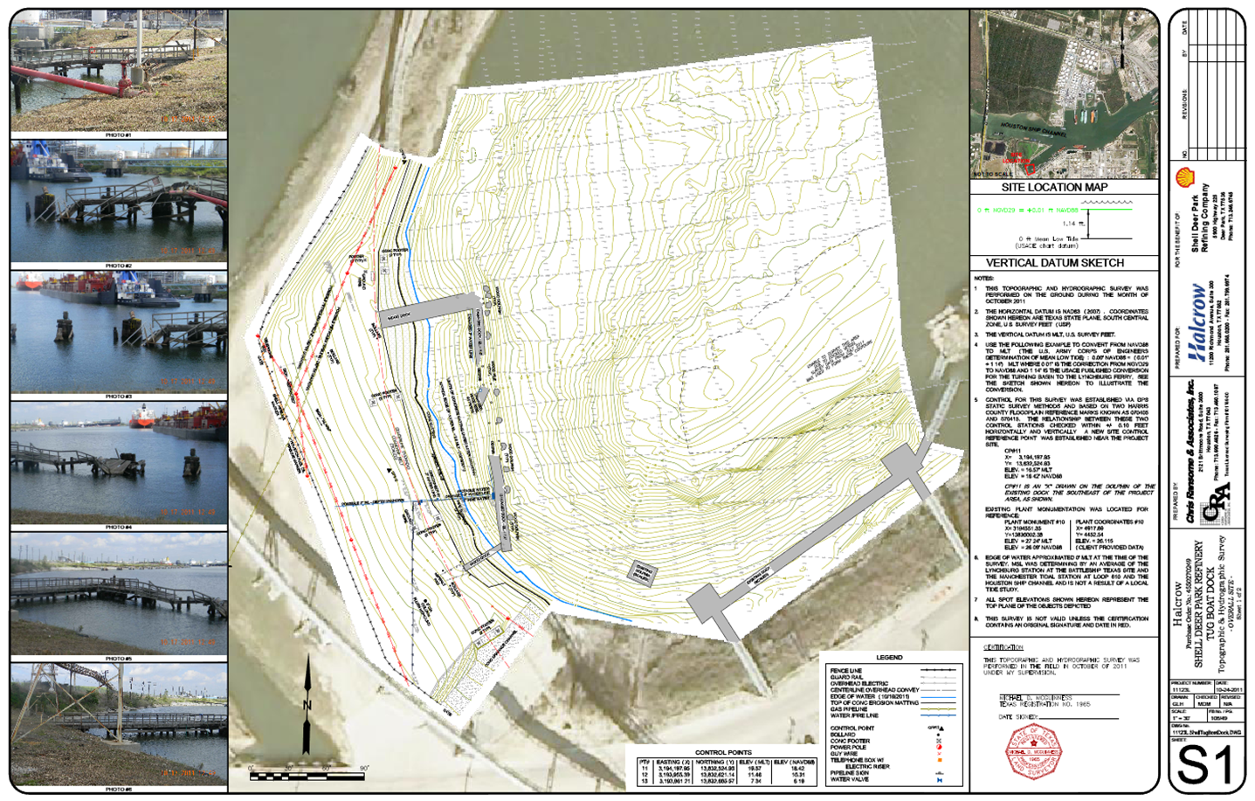
Final Products

